Slide 1
The Life of Brian
Tools to Keep the Typical UConn Employee Cyber Safe
Dustin Kirkpatrick
Notes:
First a little exercise:
Everyone raise their hands and put them down if we come to a question you answer yes to.
Who keeps passwords written down? Like on a sticky note, in a notebook, anything like that
Who keeps them in a file saved on a computer or elsewhere electronically? Word doc, Excel sheet, anything like that
Who uses the same password for more than one service? For example, on both your UConn account and Netflix, personal email, Amazon
Whose password contains personally identifiable information? Birth date, spouse/children’s name, your name. Favorite sports team?

Slide 2
Who is Brian?
Administrator in a CLAS department
Husband to Samantha
Father to two kids, Bobby and Taylor
Dog owner, Rover
Avid birder
Typical New England sports fan: Red Sox, Patriots, Celtics, etc.
Coach for Bobby’s baseball team
Organizer for Taylor’s soccer league

Slide 3
What Does Brian Have Passwords For?
Professional Accounts
Personal Accounts
NetID
HuskyCT
PeopleSoft
Kuali
Department shared email
Research grant websites
Netflix, Google, Amazon, Disney+, etc.
Facebook, TikTok, Twitter, LinkedIn
Banking websites
Birding website for tracking those elusive Lifers
Baseball and soccer websites
Other retailer portals, like Walmart, Best Buy, Costco

Slide 4
Can We Guess Brian’s Password?
Common Habits for Password Creation
Let’s Make Some Guesses
Easy to remember
Minimally complicated
Personally identifiable
Easily iterable
Universally applicable
SamandBrian2012!
TaylorDec13!
RoverGoodBoy1!
GoRedSox2018!
UConnPass15?!
R-B Merganser 2$$

Slide 5
One Day… Brian Gets an Email
One of his personal accounts has been compromised!

Slide 6
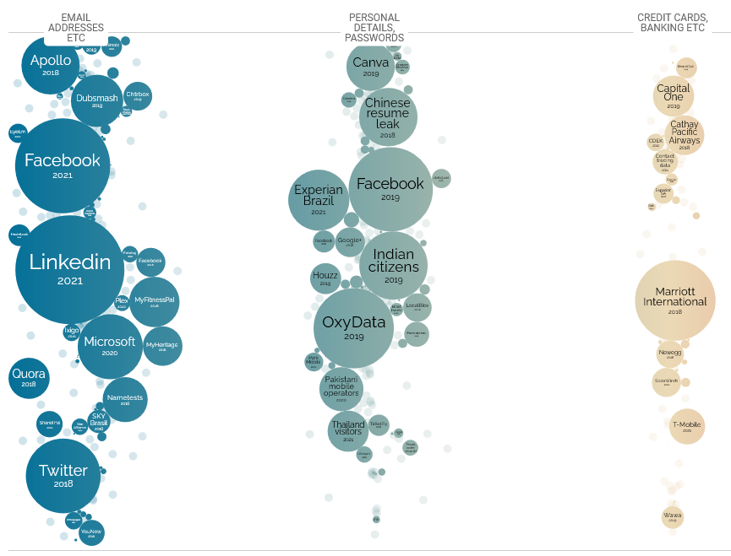
More Common Than You Think
Microsoft 2020: 250 million
Twitter 2018: 330 million
Facebook 2019: 419 million
Facebook 2021: 533 million
LinkedIn 2021: 700 million

Slide 7
Tools to Help

Slide 8
Duo
Multifactor Authentication App
A second layer of security
Can be for more than UConn
One of many solutions

Slide 9
Why is Duo/MFA important?
Let’s reconsider Brian’s example
His password was compromised elsewhere. Would attackers use it against UConn?
Yes!!!
But Duo can protect us.
Bad guys still need to get a Duo push to login

Slide 10
Standard Duo Push Process

Slide 11
When You Weren’t Expecting It
Deny the request
Change your password
techsupport@uconn.edu

Slide 12
LastPass
Password storage solution
Creates passwords for you
Can be used by up to five people
Easily separates work and personal accounts

Slide 13
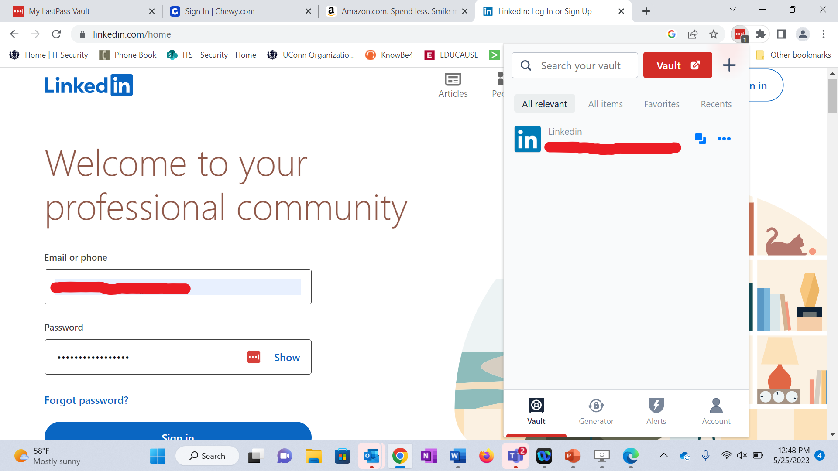
LastPass in the Browser
Notes:
Walk through how you use the extension and it auto-fills
Talk about how LastPass works for all the tabs up top.

Slide 14
How do these tools help Brian?
Netflix being compromised does not mean anything else has been
Changing compromised passwords is easy
MFA is a second layer of protection

Slide 15
Big Takeaways
Use LastPass everywhere
Use Duo everywhere
If you get a Duo push and weren’t expecting it, deny and change your password
techsupport@uconn.edu

Slide 16
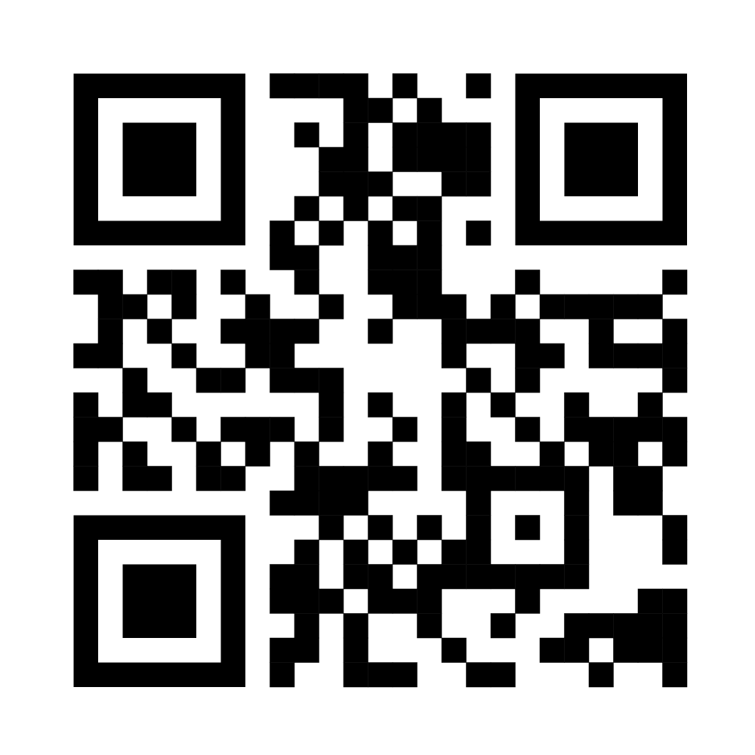
Question?
Email and Teams:
dustin@uconn.edu
Get an unprompted Duo push?
techsupport@uconn.edu
Have I Been Pwned
LastPass:
https://s.uconn.edu/lastpasskb
Duo:
https://s.uconn.edu/duokb

