Slide 1
Add Teams to your Team
University-wide, real-time collaboration
Dan Jakubiak
Applications Administrator
Technology Support Center
daj@uconn.edu

Slide 2
Microsoft Teams
Included in the Microsoft 365 suite
Formerly known as Office 365
Work in real-time with anyone in the university
Instant Messaging (IM)
Voice and Video calls
Share files
Cross-platform support

Slide 3
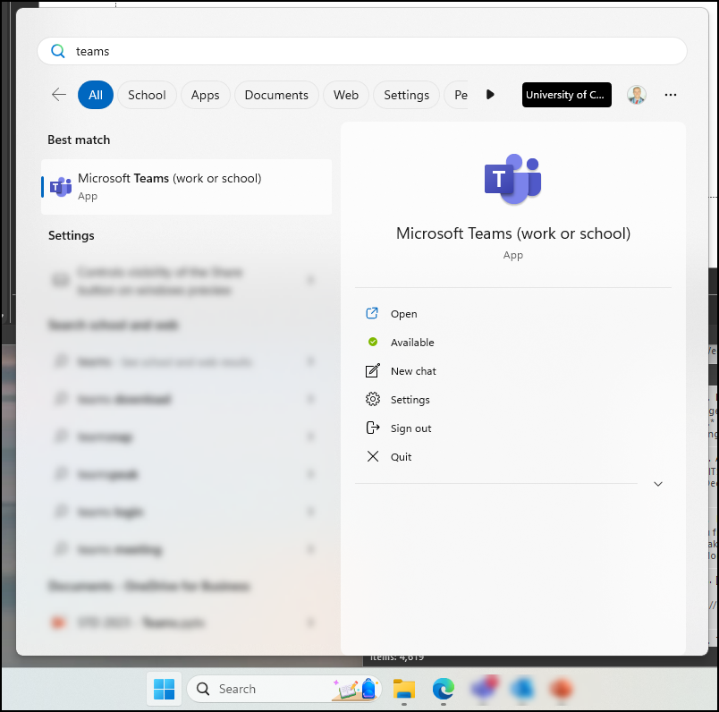
Where to find Teams
Pre-installed on University devices
Fully functional web app
teams.microsoft.com

Slide 4
Overview
Send Instant Messages to individuals and groups
Video Calling
Create teams for collaboration
Add a Teams Meeting to Outlook Calendar
Use Live transcriptions
Create and Follow Tasks

Slide 5
Main Navigation
Left-hand navigation bar
We’ll revisit this slide at the end

Slide 6
Chat
Similar concept to AOL Messenger or Facebook Messenger
Quickly send messages to anyone in the University
Send files from Computer or OneDrive/Sharepoint
Quickly Transition into a voice/video call
Send messages to yourself
Edit messages after sending

Slide 7
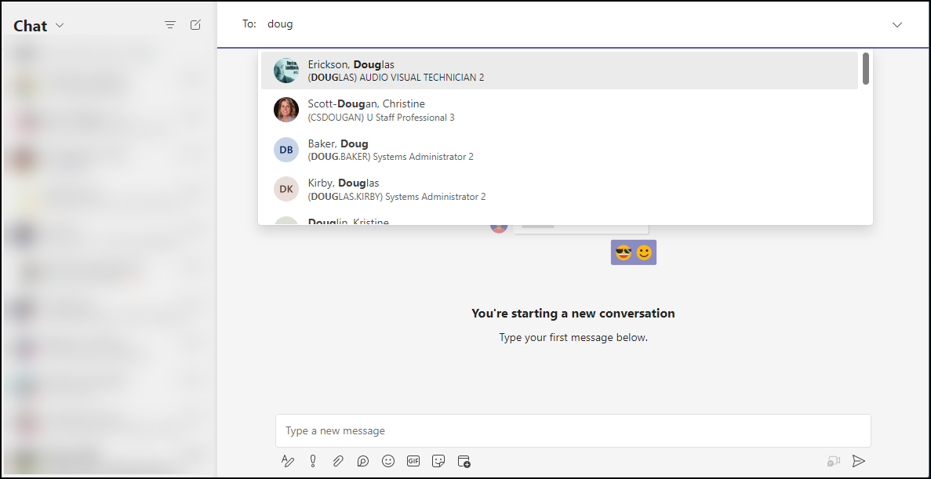
Starting a Chat
“instant messaging”
“chats”
“messages”

Slide 8
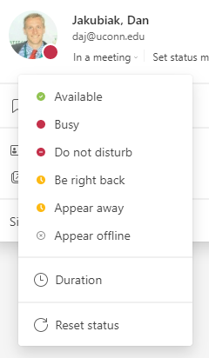
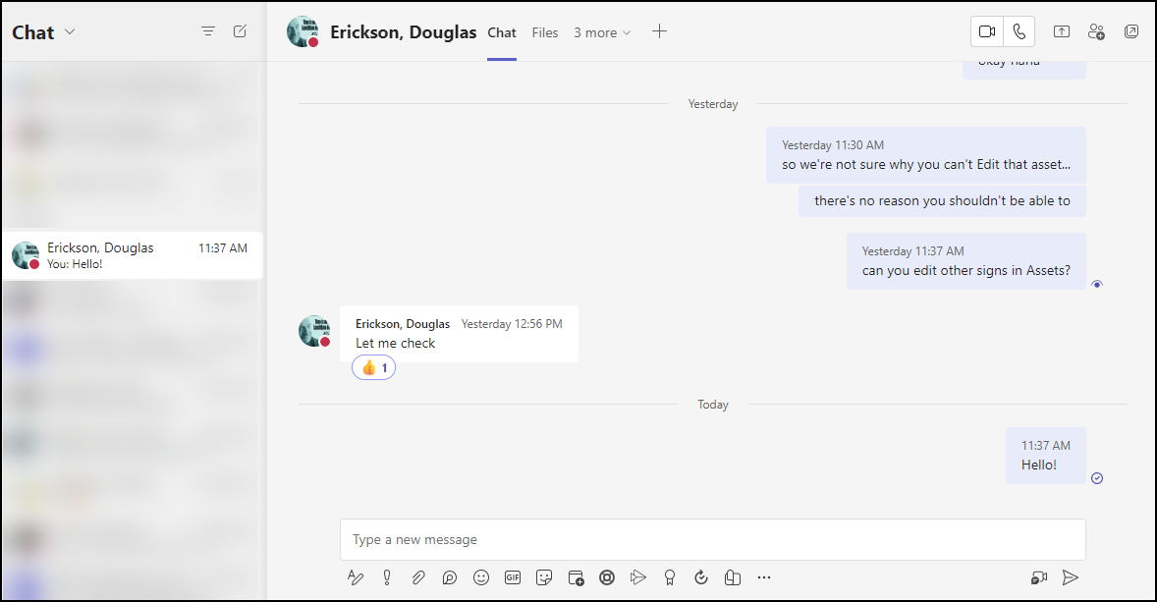
1:1 Chat

Slide 9
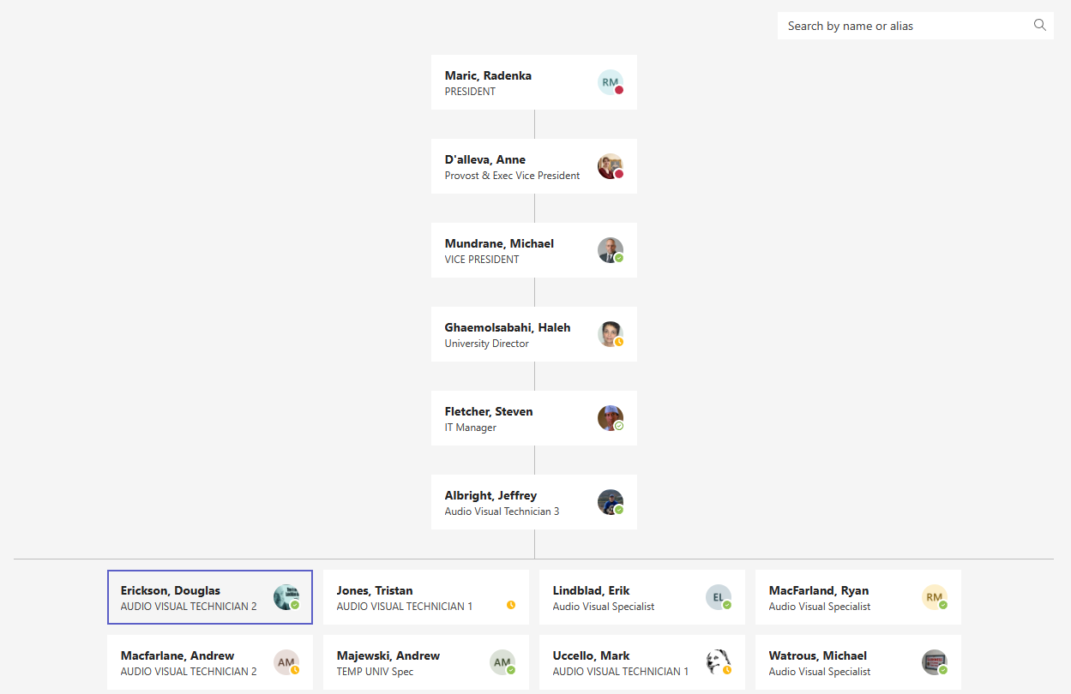
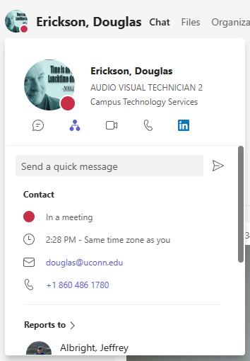
Organizational Chart

Slide 10
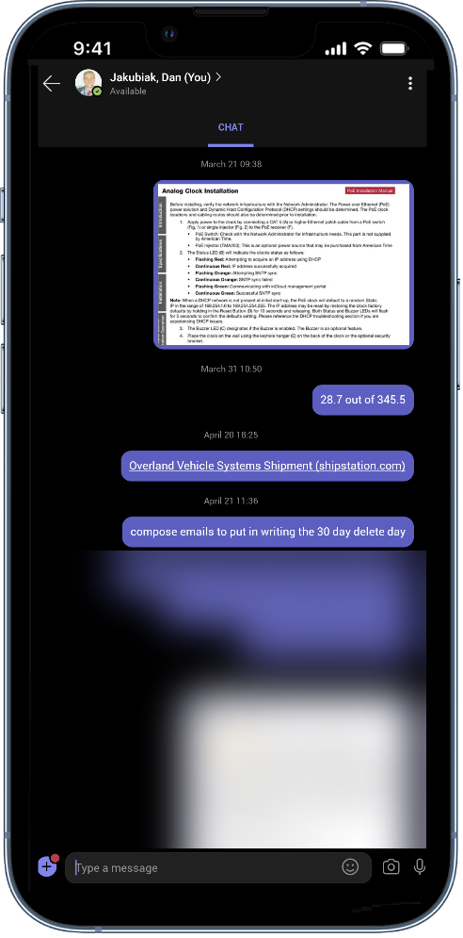
Self Chat

Slide 11
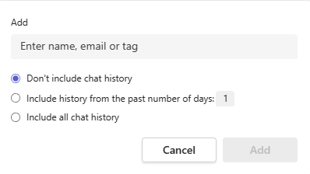
Easy Group Messaging

Slide 12
Message Features
Change Style

Slide 13
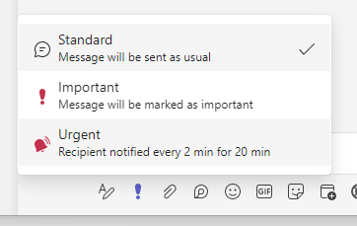
Message Features 2
Set Importance Level
A message marked as Important or Urgent will send an email to the recipients as well

Slide 14
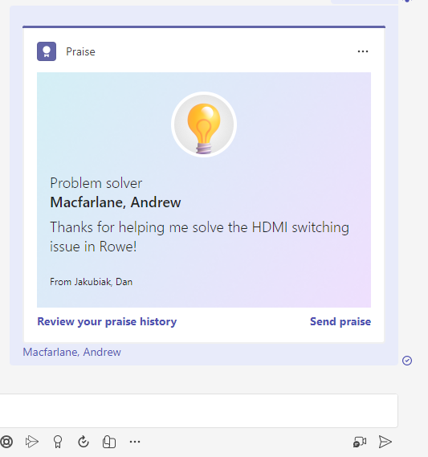
Message Features 3
Send Praise

Slide 15
Video Conferencing
Jump into a video call with the push of a button

Slide 16
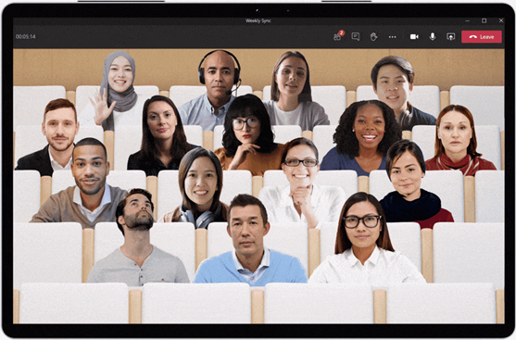
Virtual Backgrounds
Image source: Microsoft

Slide 17
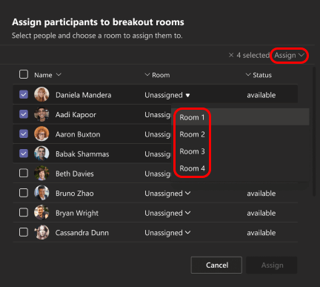
Breakout Rooms
<300 People
Up to 50 rooms
Create before or during meeting
Can set time limit
Automatically move participants
Image source: Microsoft

Slide 18
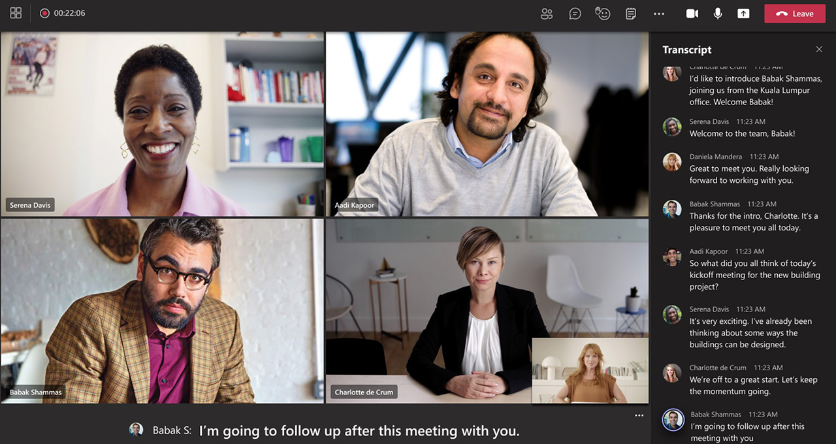
Live Transcription
Great for noisy environments
Post-meeting review
Image source: Microsoft

Slide 19
Video Conferencing 2
Image source: Microsoft

Slide 20
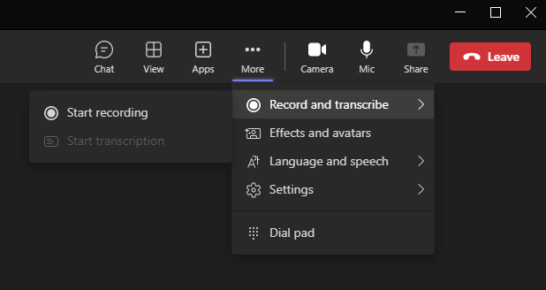
Turn on Transcription
A function of the recorder
Turn on recording
Image source: Microsoft

Slide 21
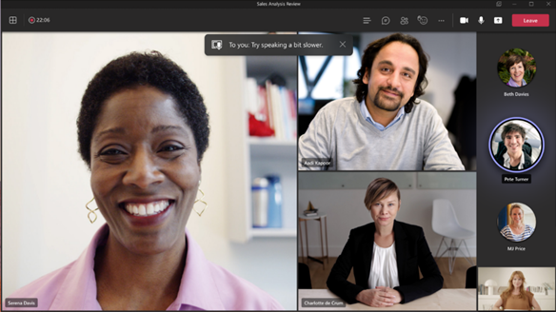
Video Conferencing 3
Speaking Coach
Private feedback in the meeting
Checks for pacing and pitch
Checks for filler words, informal speech and euphemisms
Image source: Microsoft

Slide 22
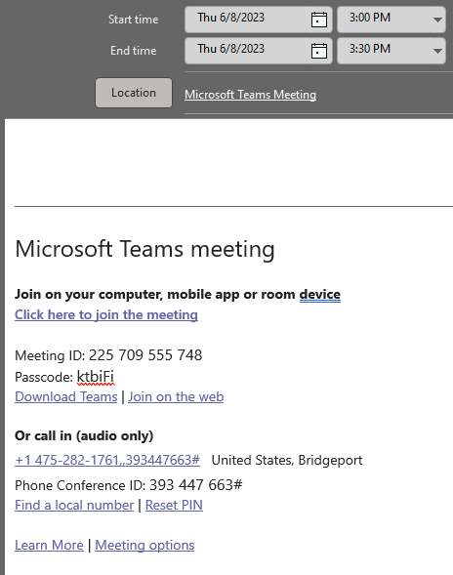
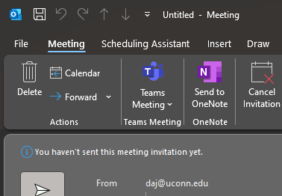
Teams and Outlook
One-button to add a Teams video conference to an Outlook calendar invite

Slide 23
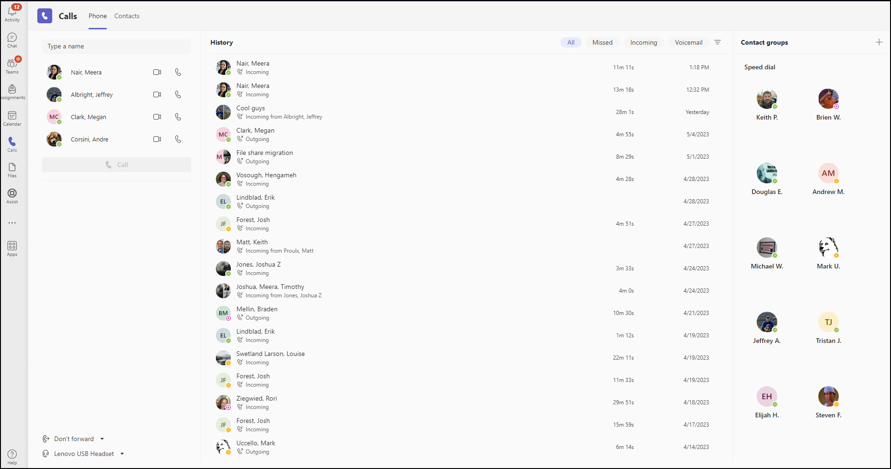
Calling

Slide 24
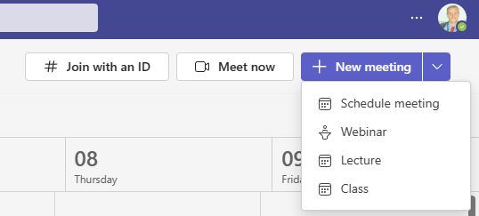
Type of Conferences

Slide 25
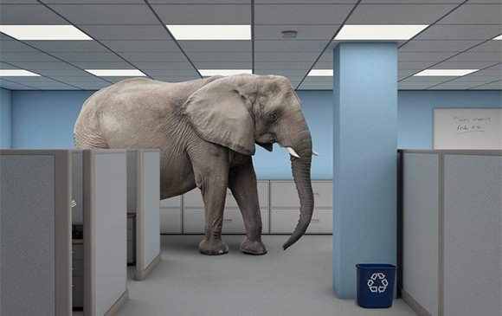
Microsoft Teams - teams
teams are created within Teams
Within the program “Microsoft Teams” users create teams to collaborate on projects
Image source: eosworldwide.com

Slide 26
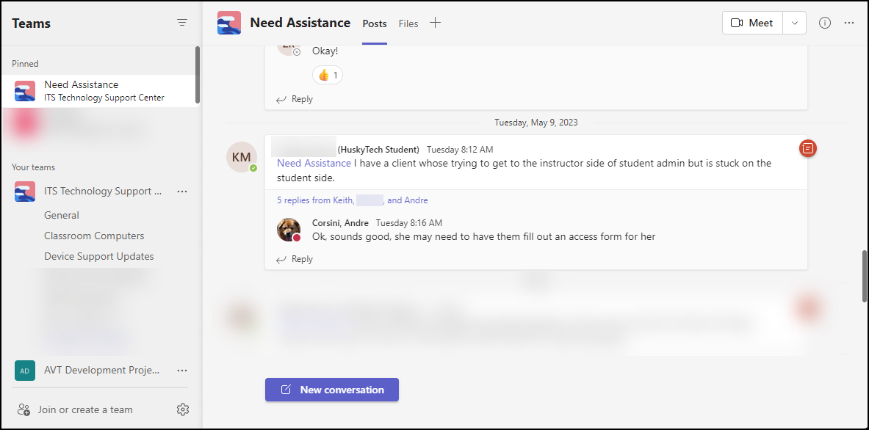
Microsoft Teams – teams cont.

Slide 27
Tasks

Slide 28
Tasks cont.

Slide 29
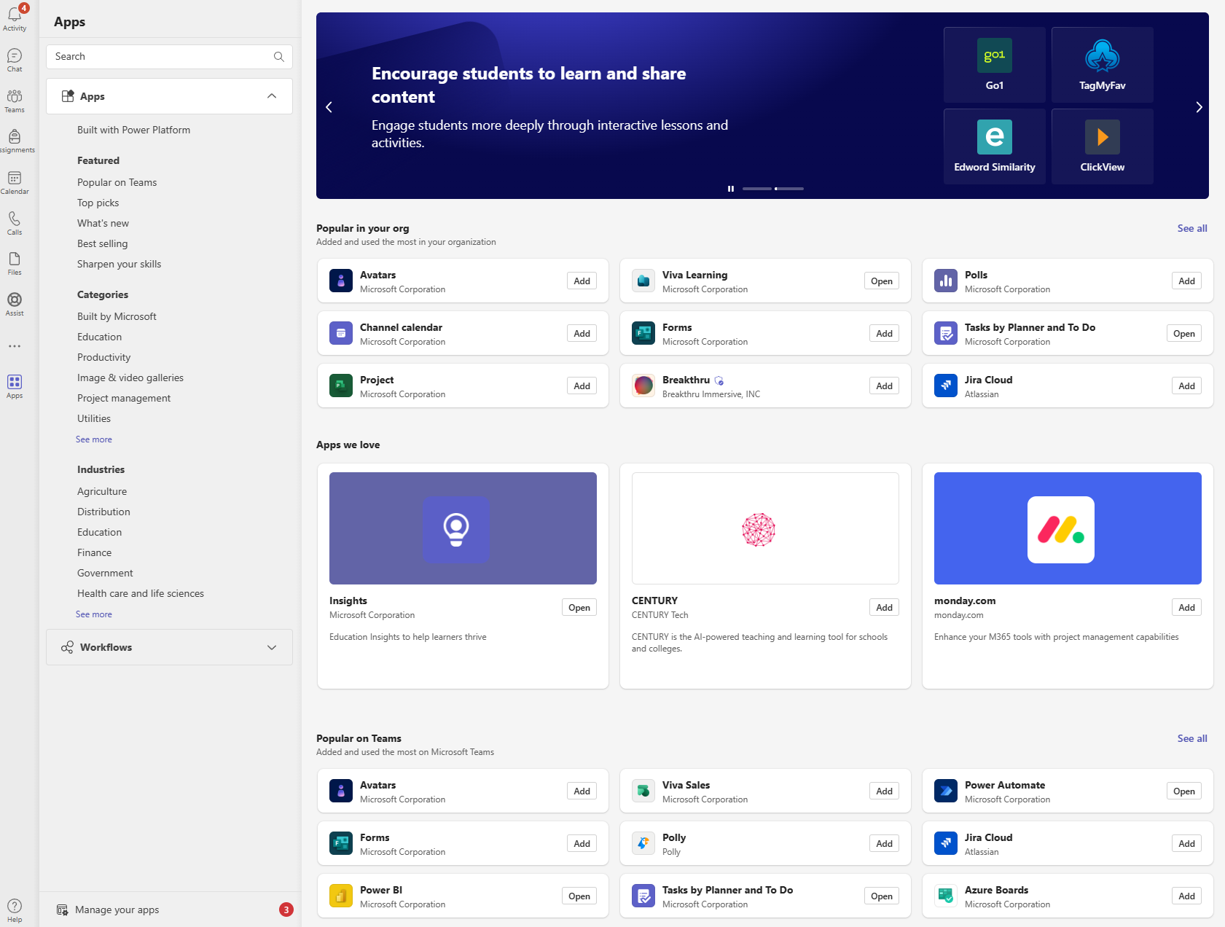
App Integrations

Slide 30
Main Navigation cont.
Left-hand navigation bar

Slide 31
Alternative to Teams
Teams is perfect for departmental or multi-department collaboration.
What if I’m teaching a class, and want a more lightweight experience?

Slide 32
Alternative to Teams cont.
Teams is perfect for departmental or multi-department collaboration.
What if I’m teaching a class, and want a more lightweight experience?

Slide 33
Webex
Video conferencing for large groups
Light-weight conferencing compared to Teams
Recordings can be shared after call with Transcripts
Strong UConn ITS presence
Breakout Rooms
s.uconn.edu/webexhelp

Slide 34
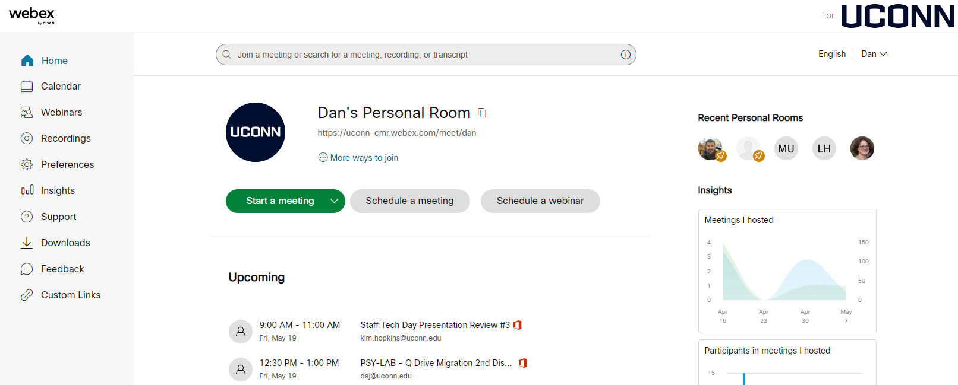
Webex cont.
Web App
s.uconn.edu/webex

Slide 35
Webex vs Teams
Both installed on all classroom computers
Both have Web App and Desktop App
Attendance Stats

Slide 36
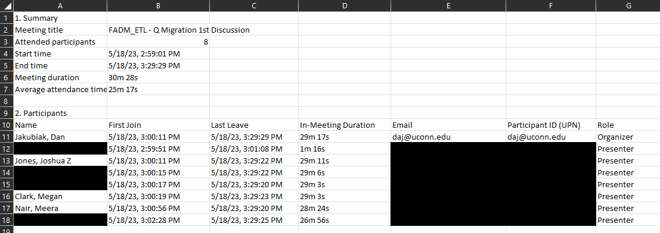
Attendance - Teams

Slide 37
Webex vs Teams cont.
Both installed on all classroom computers
Both have Web App and Desktop App
Attendance Stats
Teams = impromptu meetings with coworkers/Huskies
Webex = scheduled, large meetings with Huskies/public, especially classes

Slide 38
Quick Summary
Teams
Real-time, easy communication and collaboration with anyone in the university
Webex
Lightweight, powerful video conferencing with internal and external participants
Staff, faculty, and students have full access to Teams and Webex

Slide 39
Are you using Teams?
Tips for me?

Slide 40
Thank you!
For further reading, visit s.uconn.edu/teamshelp
To try out Teams, visit teams.microsoft.com
For information on Webex, visit s.uconn.edu/how2webex
To try out Webex, visit s.uconn.edu/webex
My info:
Dan Jakubiak daj@uconn.edu
techsupport@uconn.edu

