Slide 1
It’s A Trip!
How to make Returning from Travel Easier with the Concur Mobile App
Brett Paulson & Bryon Moore, Financial Systems

Slide 2


Introduction
BRYON
BRETT
Traveler
Delegate for Brett
Supervisor
Know-It-All

Slide 3
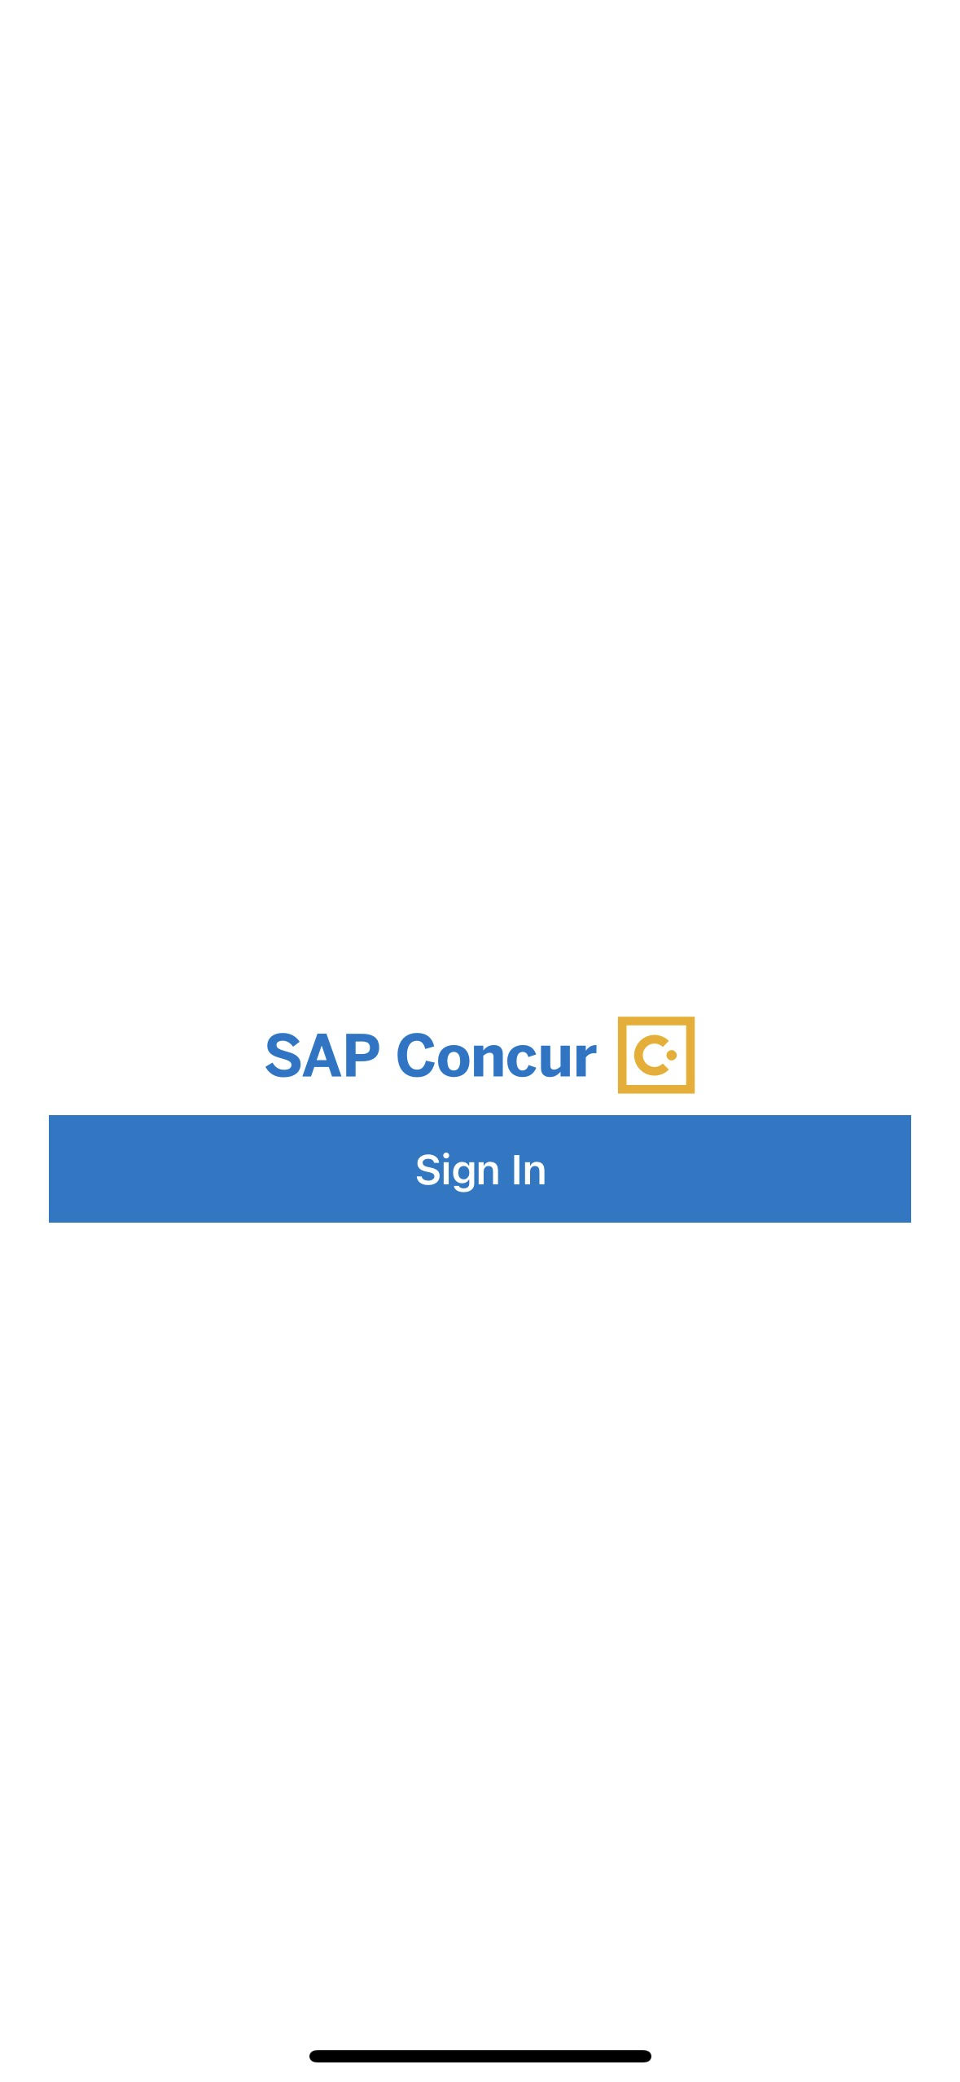
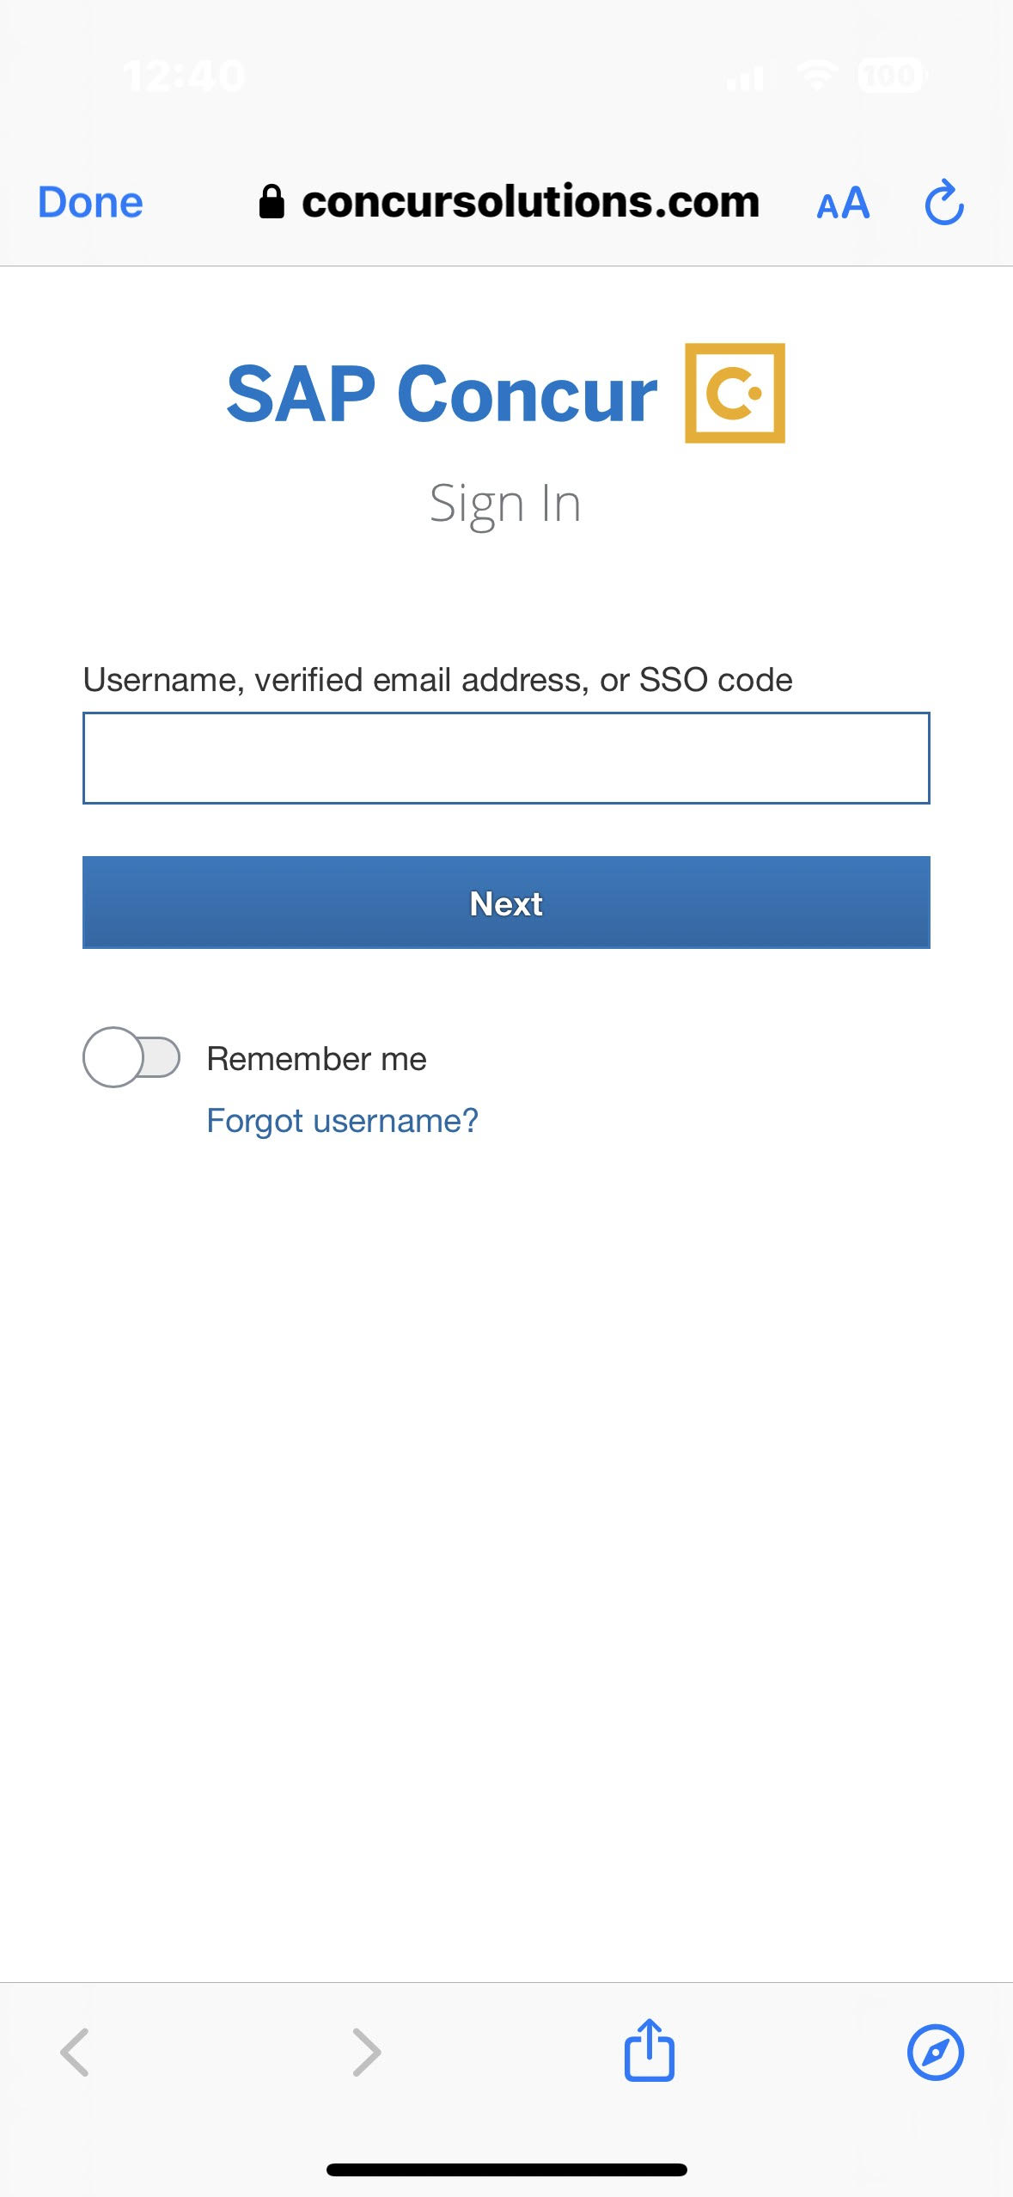
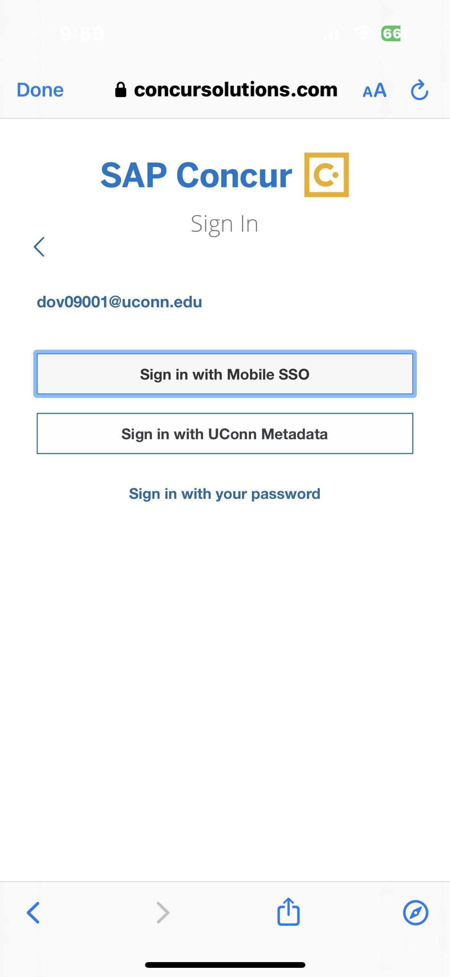
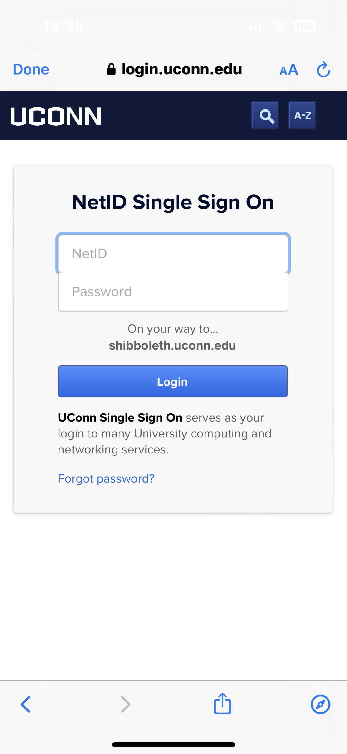
Logging Into the App - First Time
Open the Concur App. Select Sign In.
2. Enter your NetID@uconn.edu as the username.
3. Select the "Sign in with Mobile SSO" option
4. Enter your NetID and password to log in
abc12345@uconn.edu
abc12345@uconn.edu
Note: you can use your email address first.last@uconn.edu to login after the 1st time

Slide 4
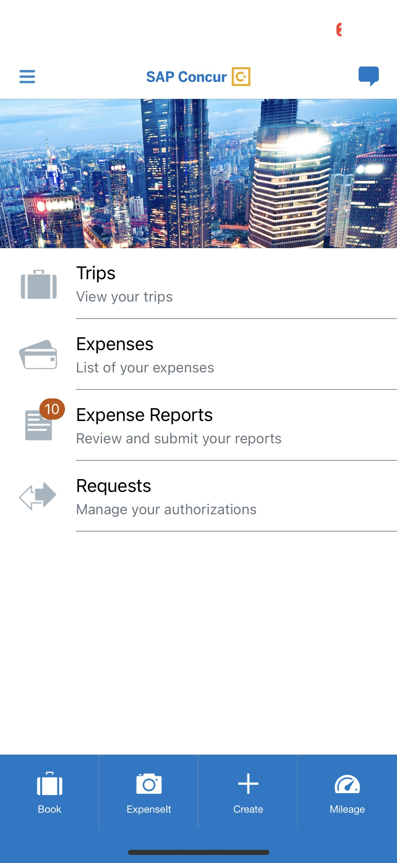
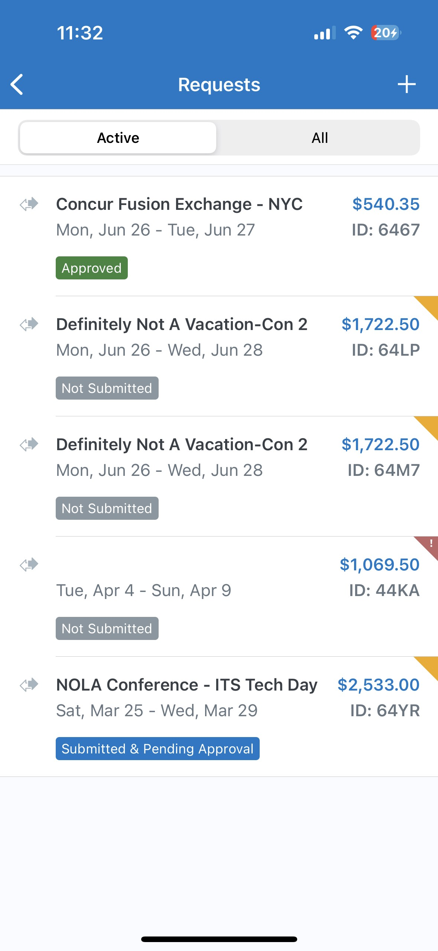
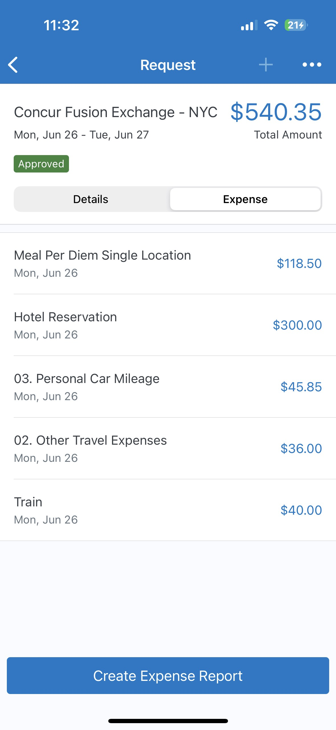
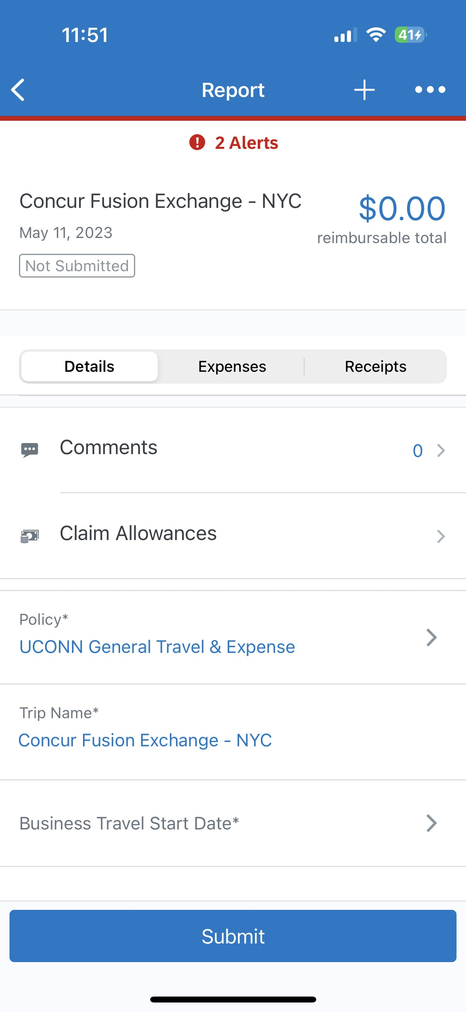
Creating an Expense Report From a Request
Go to Homepage. Select Requests.
2. Select the Approved Request.
3. Select "Create Expense Report"
4. Go to "Details" to Complete the Report Header

Slide 5
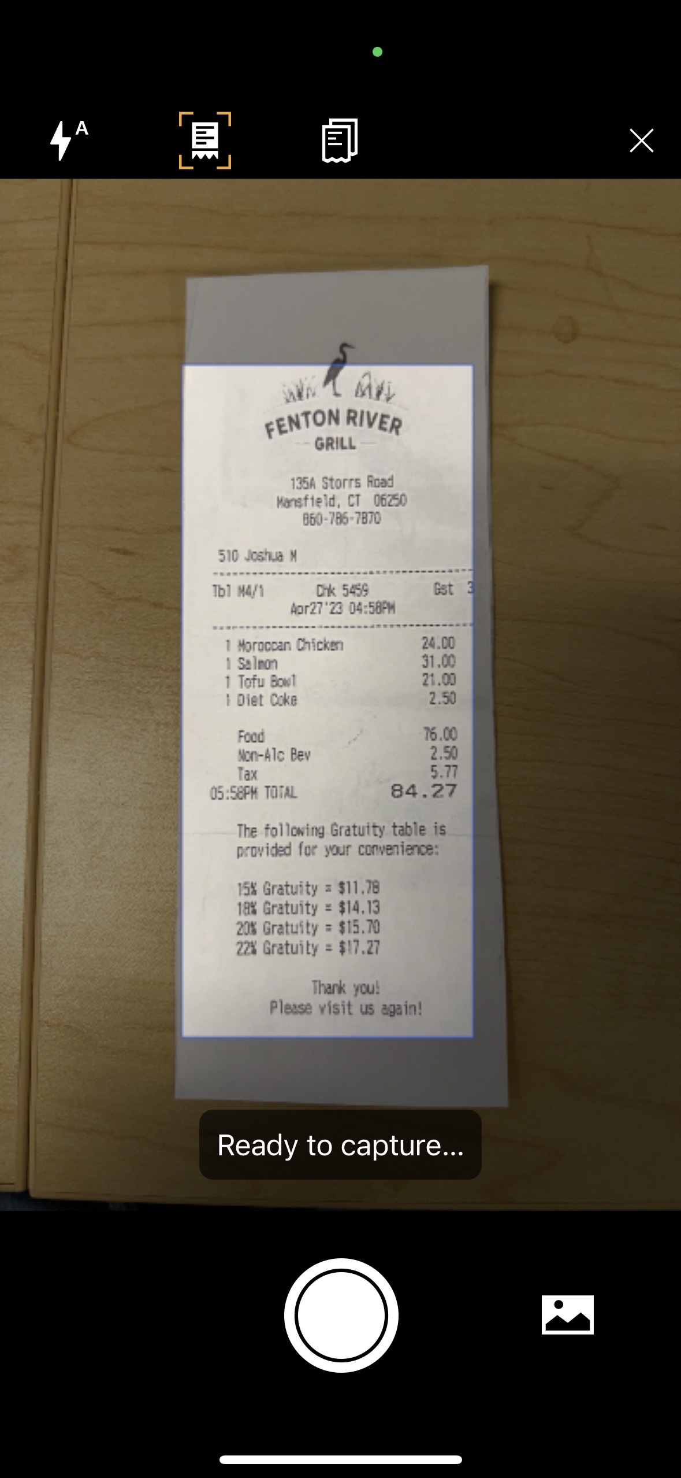
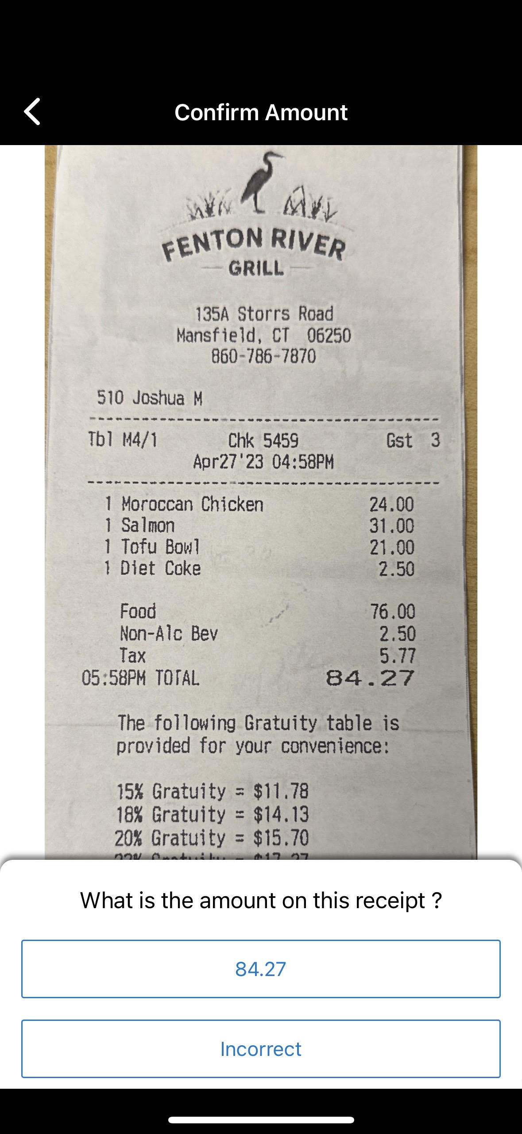
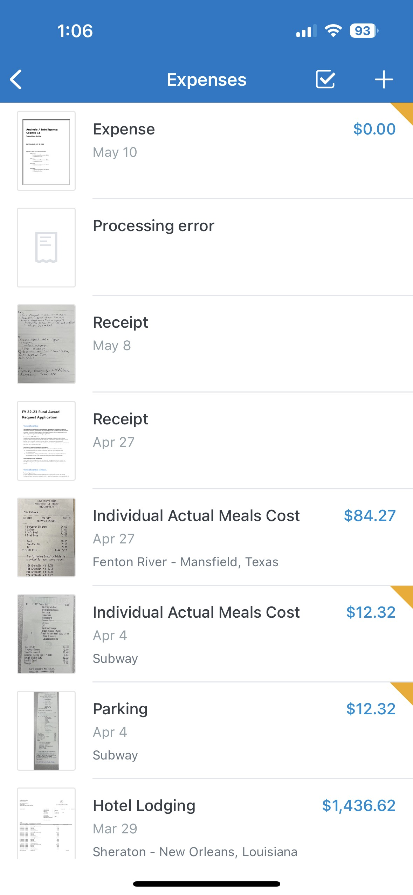
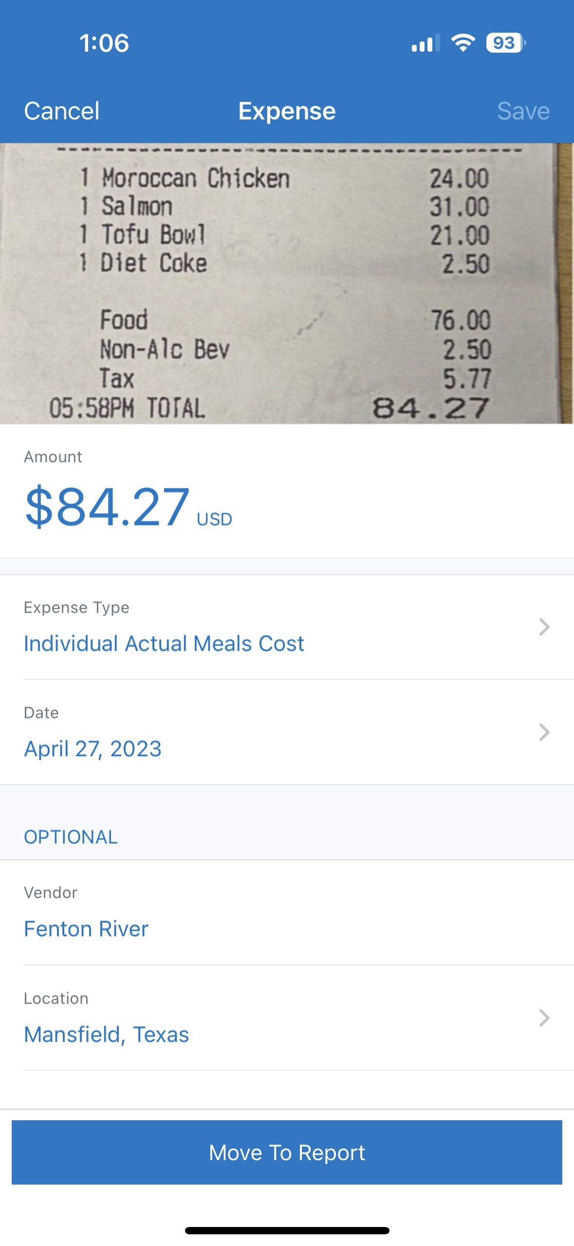
Creating an Expense From a Simple Receipt
Go to Homepage. Select ExpenseIt Icon.
2. Take a Picture of Your Receipt. Verify the amount.
3. Select the Created Expense. Verify the Information. Click "Move to Report"
The ExpenseIt feature isn't always 100% accurate!

Slide 6
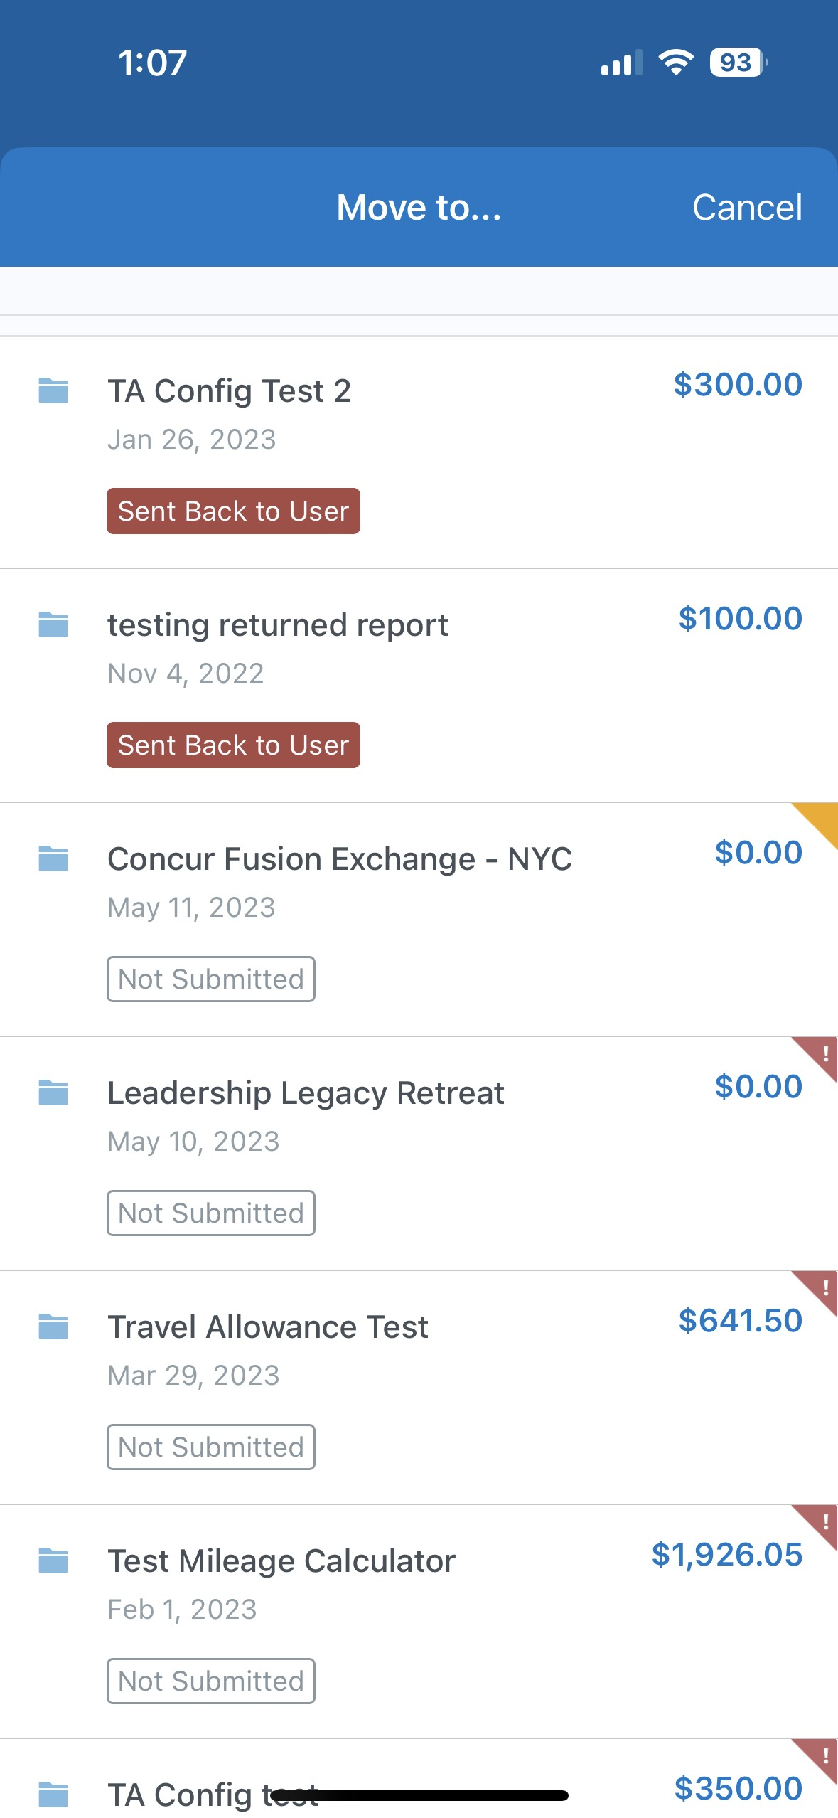
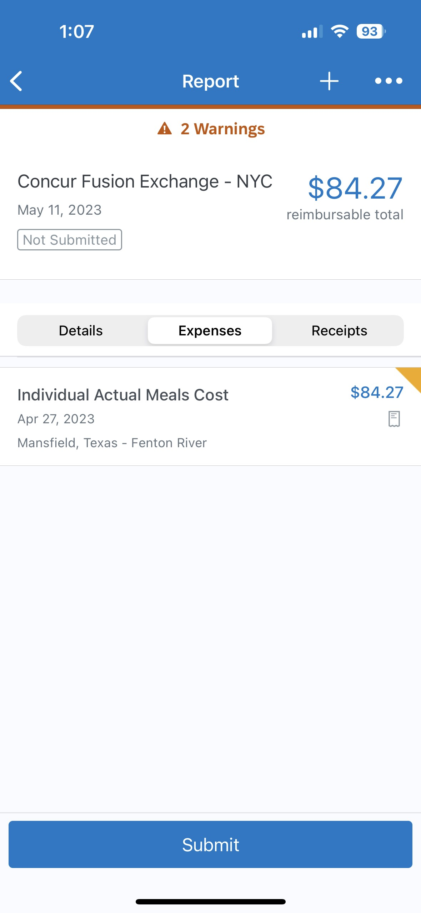
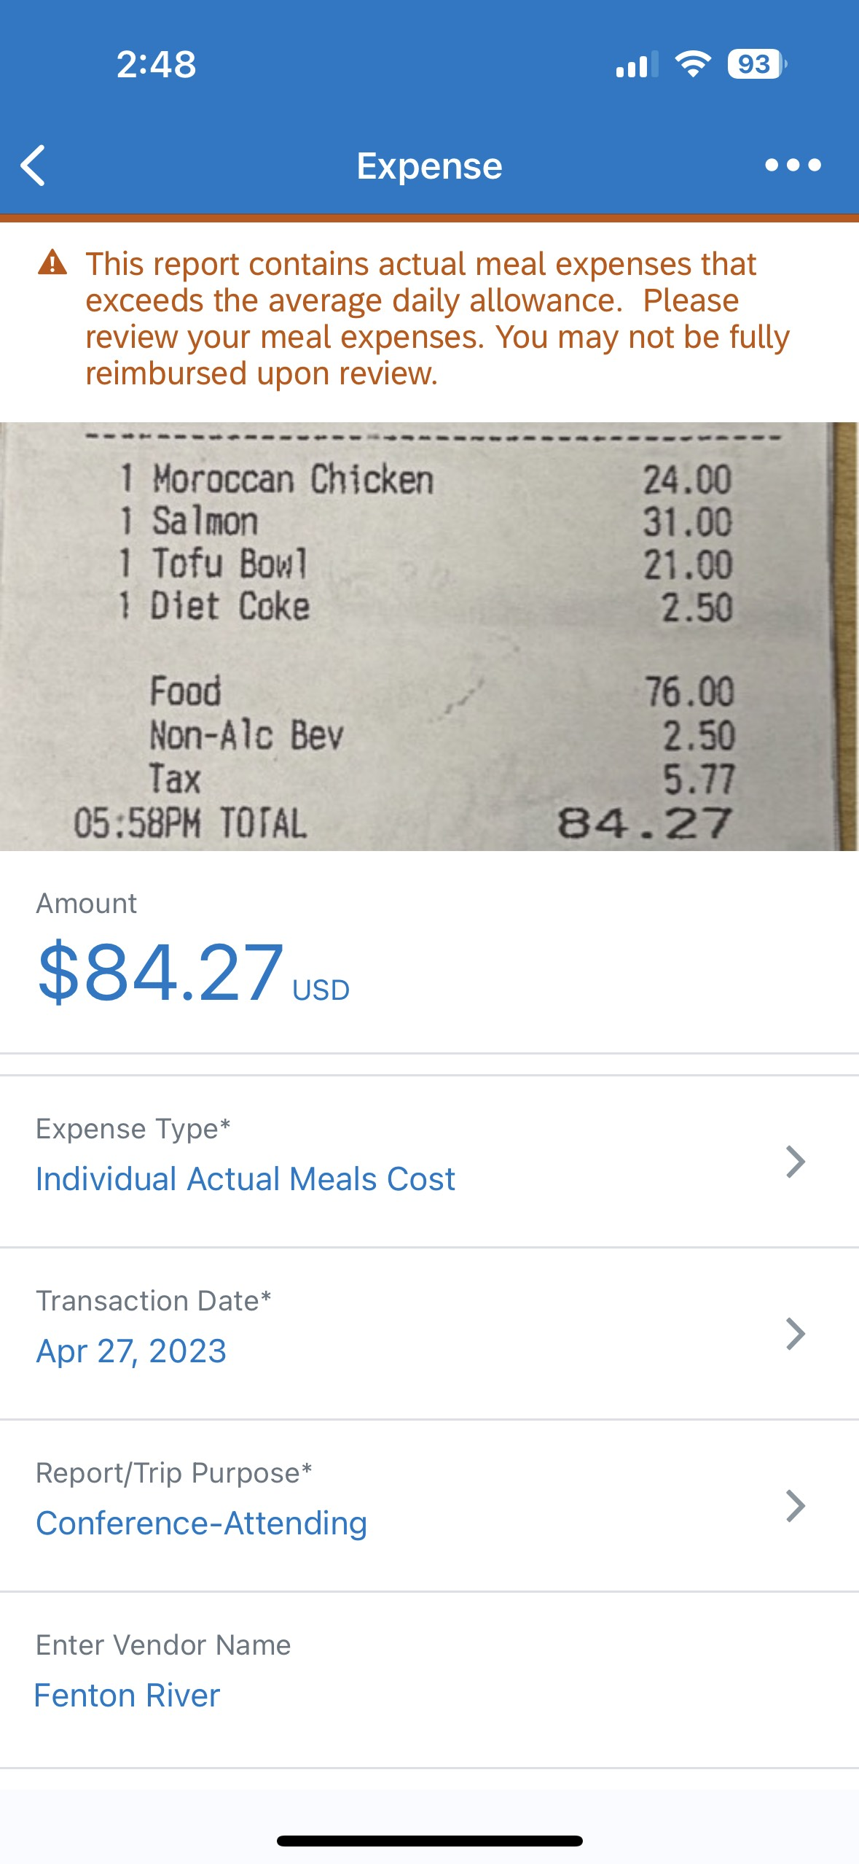
Creating an Expense From a Simple Receipt cont.
4. Select the Expense Report to add the Expense
5. View the Expense in Your Report

Slide 7
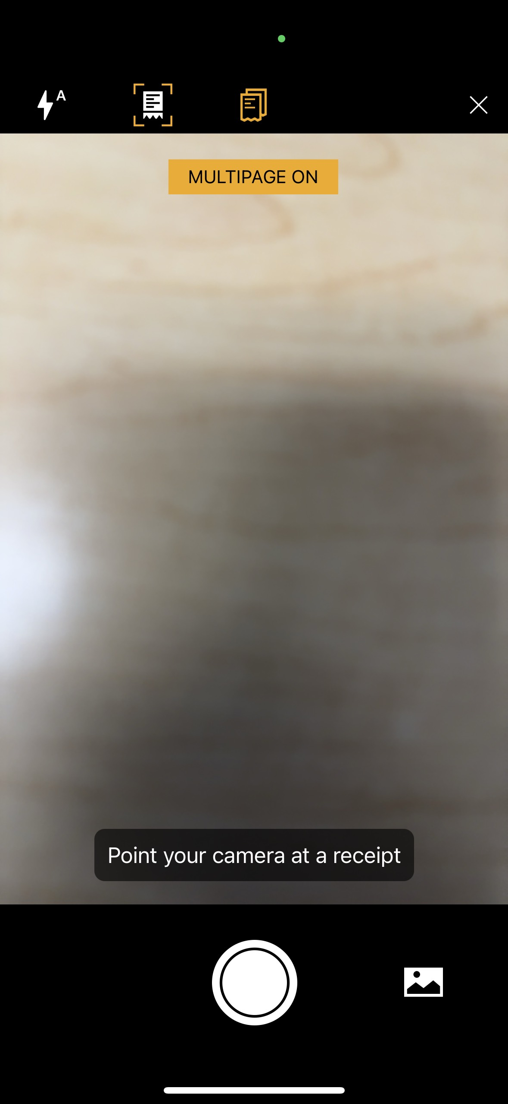
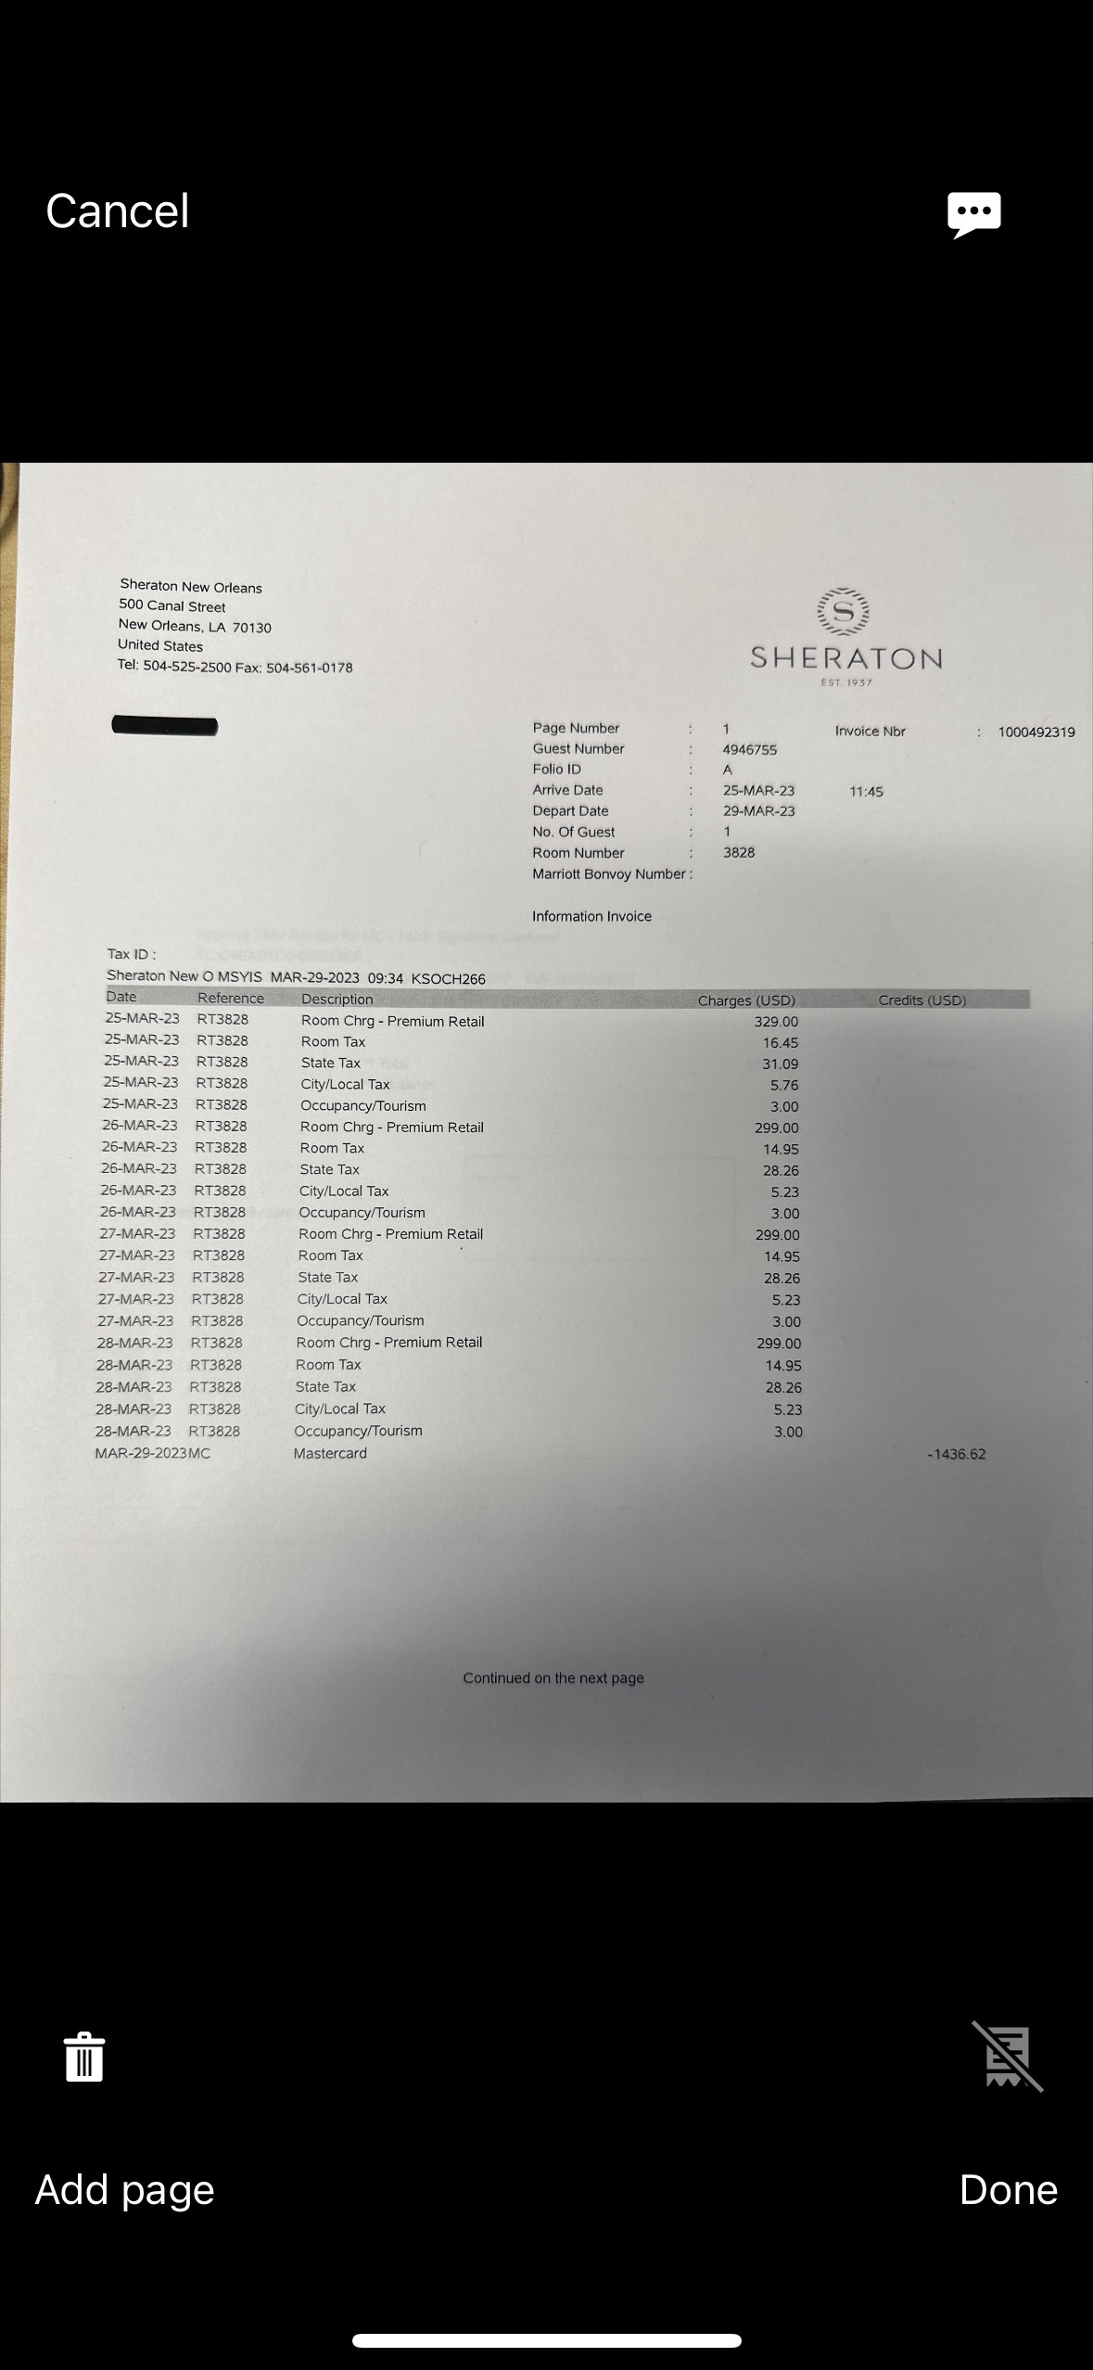
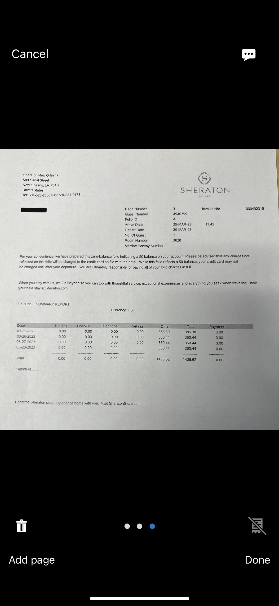
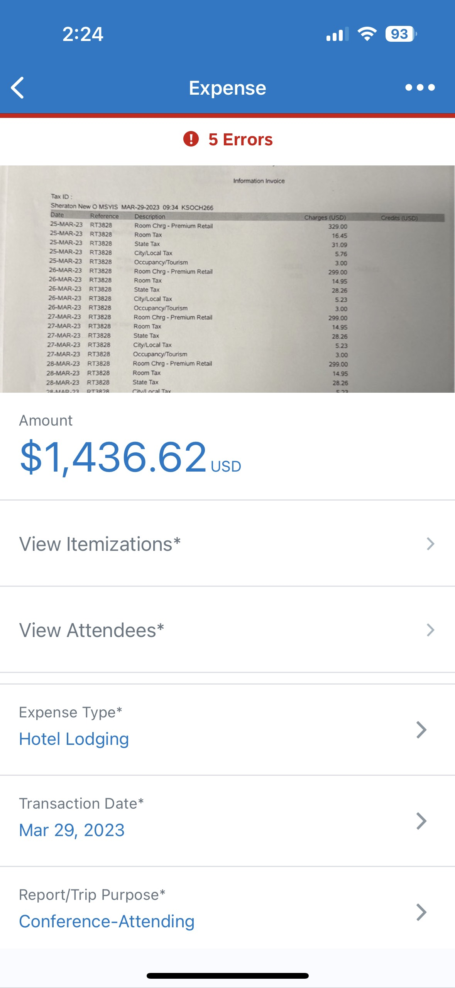
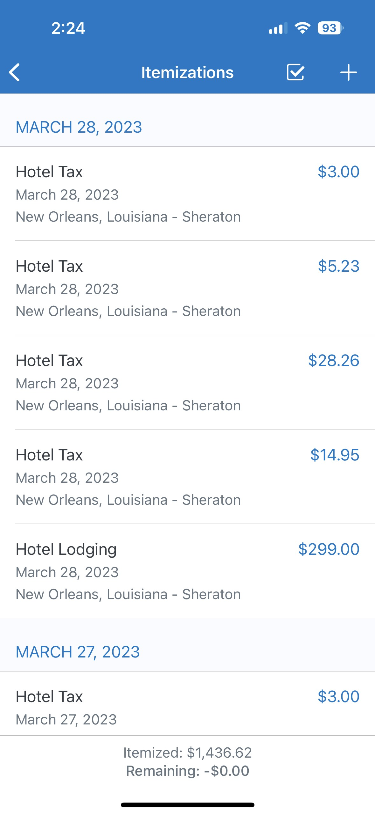
Creating an Expense From a Multi-Page Receipt
After Selecting the ExpenseIt Icon, click the Multipage Icon
2. Take a Picture of Your Receipt. Click "Add Page" to add pages to receipt until complete.
3. After moving the expense to a report, select it to view and verify info and itemizations

Slide 8
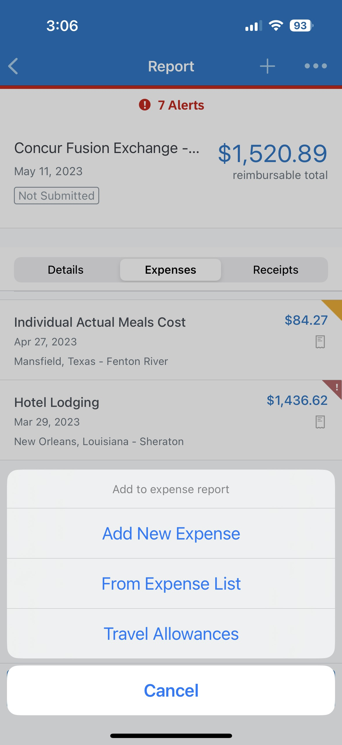
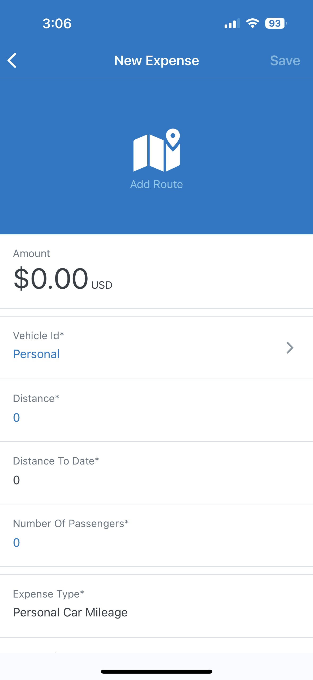
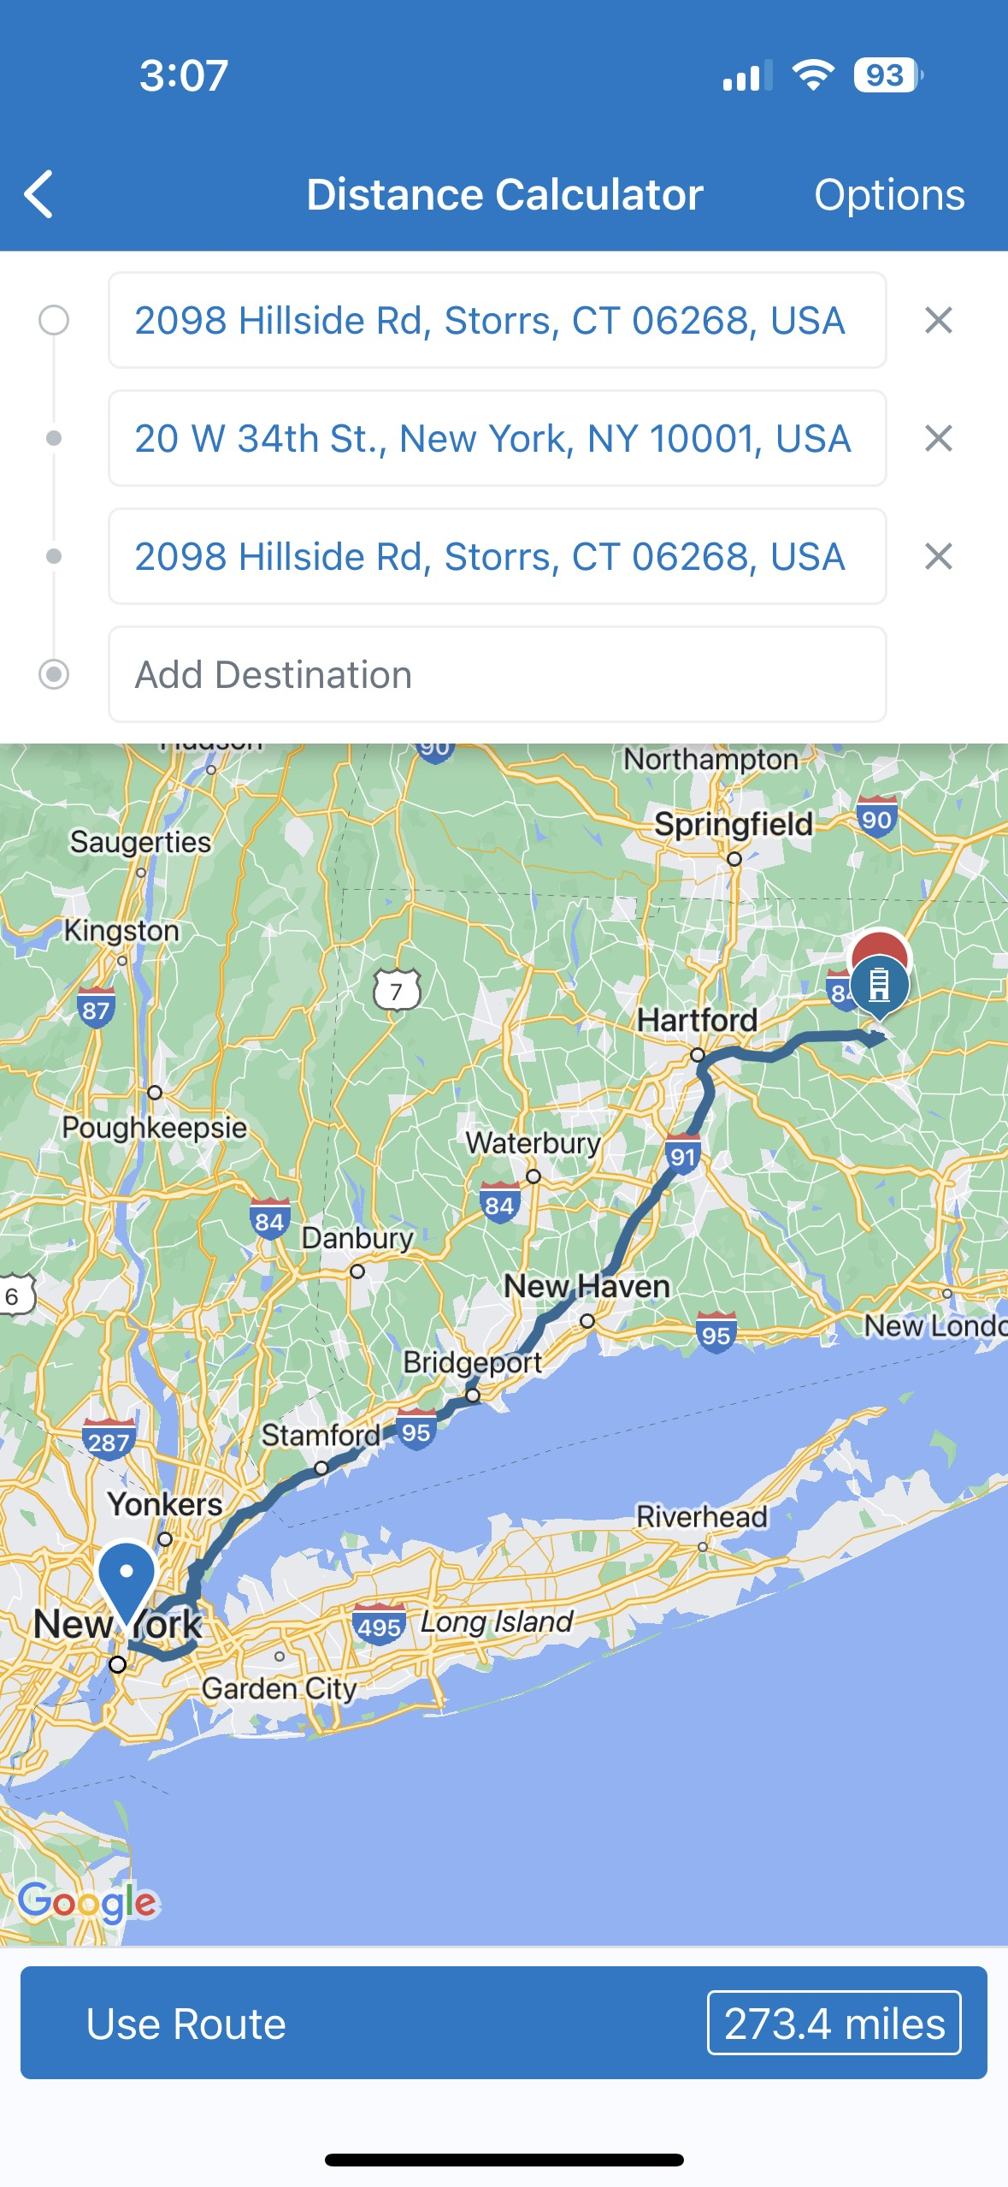
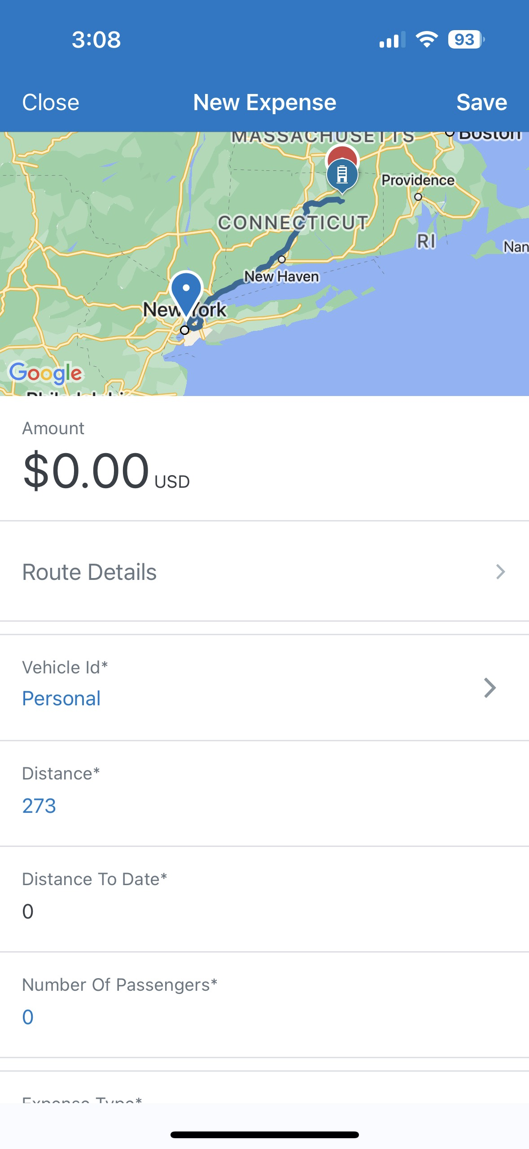
Creating A Mileage Expense
After Selecting a Report, Add Expense Icon --> Add New Expense
2. Click the Add Route Icon, enter your travel route, click "Select Route" when finished.
3. Save the Expense or enter commute deduction by clicking "Route Details".

Slide 9
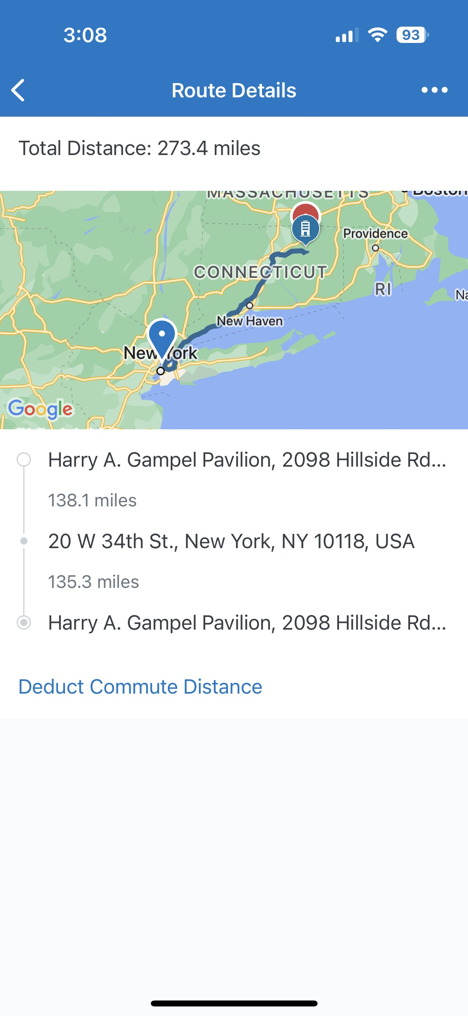
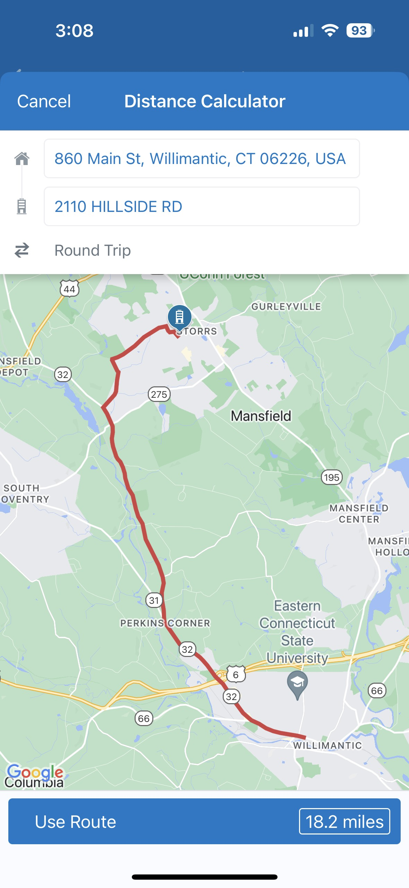
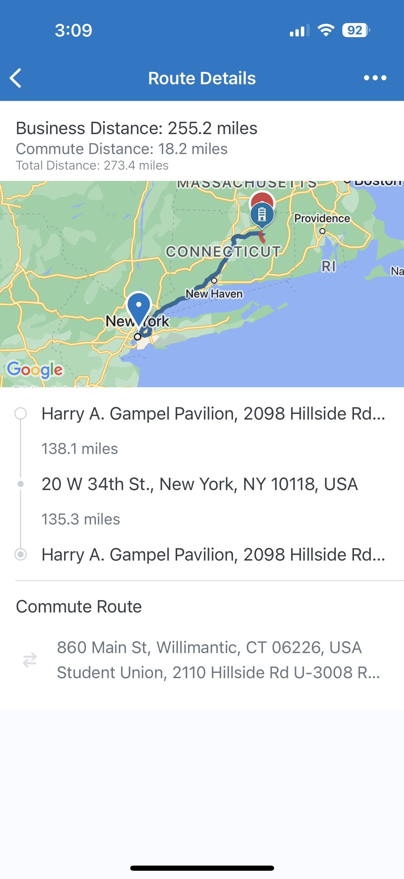
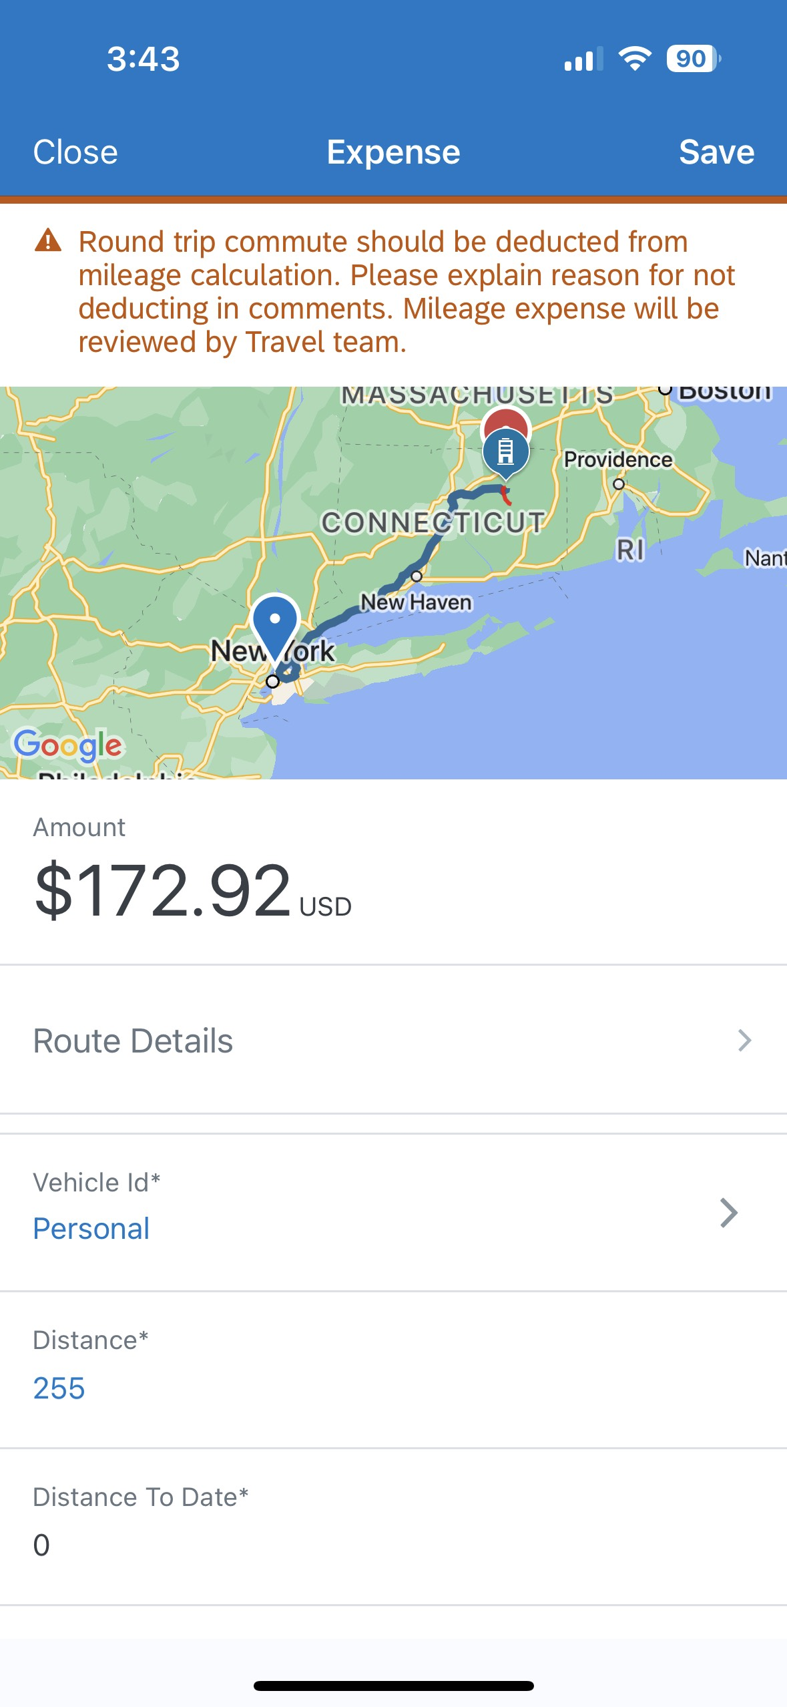
Creating A Mileage Expense cont. (Deducting Commute)
1. Click "Deduct Commute Distance" to enter your commute route.
2. Click the Round Trip Icon to toggle between One Way and Round Trip. Click "Use Route" to save.
3. Use the back arrow to return to the main expense screen. Click Save.

Slide 10
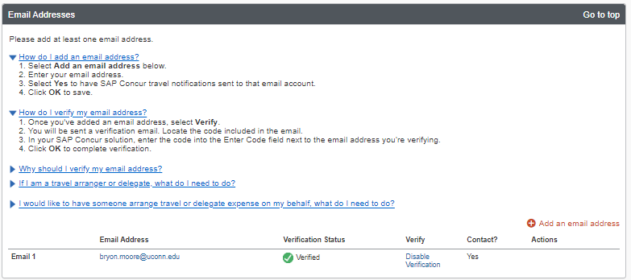
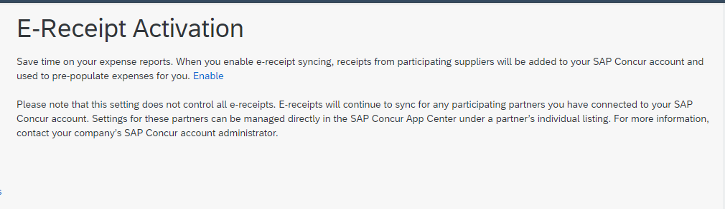
Check your Profile Settings!
1. Make sure your email is verified in your Concur Profile:
Profile Settings > Email Addresses (Under Your Information)
If your email's verification status is not "Verified", follow the instructions in the section's FAQs
2. Make sure you have E-Receipts turned on:
Profile Settings > E-Receipt Activation (Under Other Settings)
If you see the below message, click the "Enable" button to activate E-Receipts

Slide 11
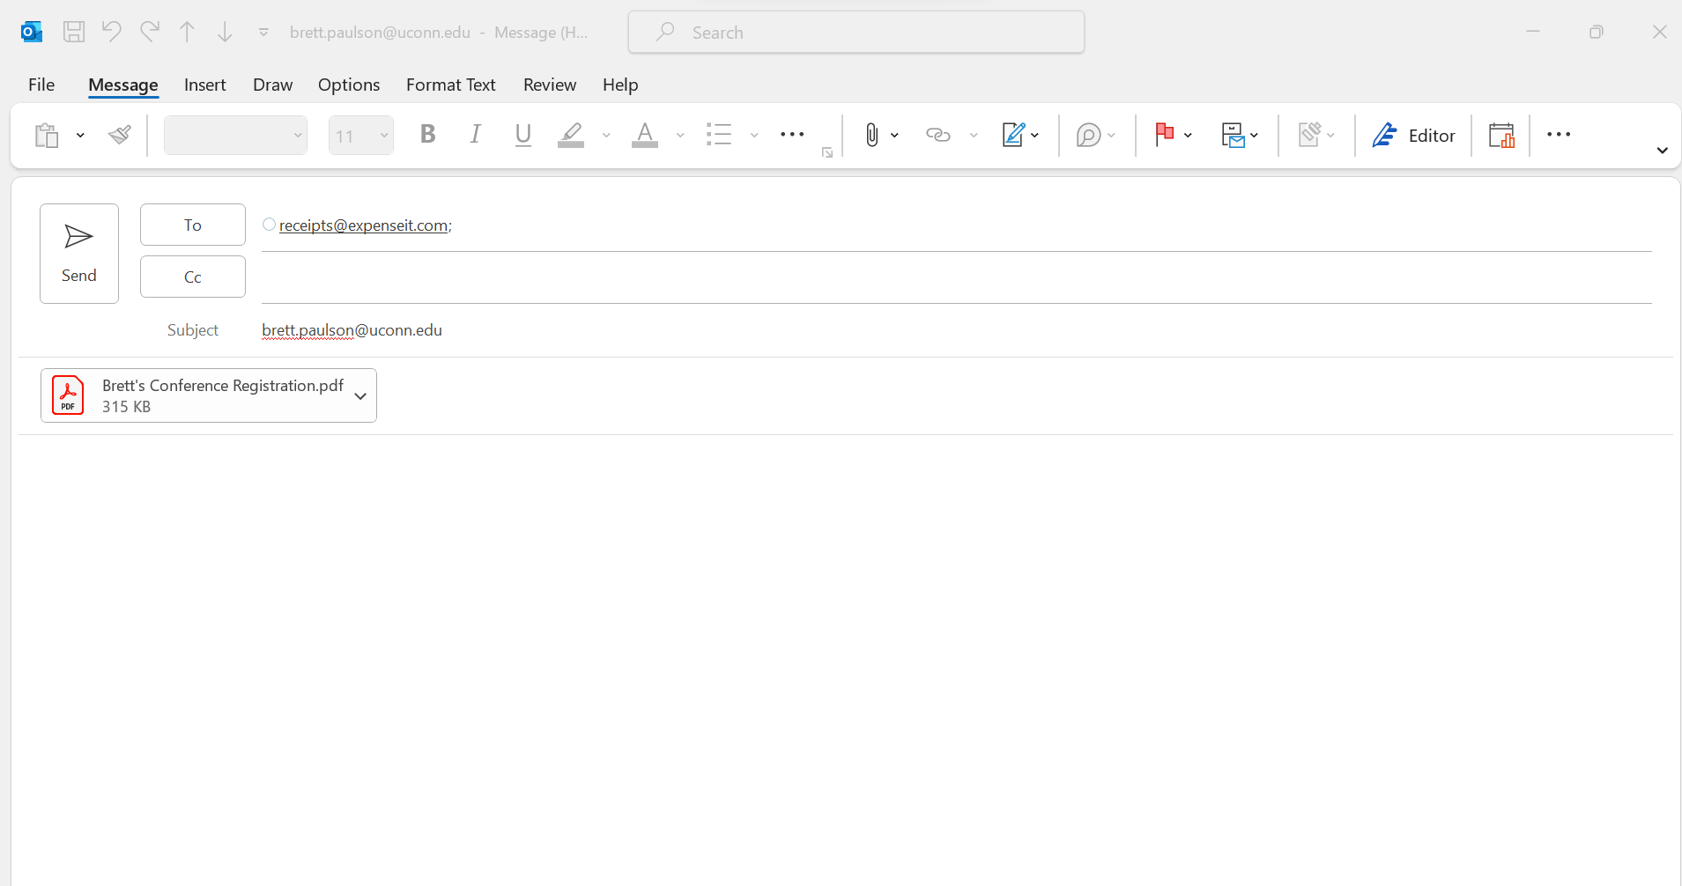
Adding Receipts via Email
1.Open a new email, or forward an existing email with receipts@expenseit.com in the "To" field. Attach your receipt(s).
2. If you are uploading a receipt for another employee, enter their email in the Subject line
Note: You must be setup as the traveler's delegate, and email address in both profiles must be verified
Be aware of the receipt limitations:
Accepted File Types: .png, .jpg, .jpeg, .pdf, .tif or .tiff.
File Size Limit: 5MB
*Go to the Mobile App to use ExpenseIt on any emailed receipts*

Slide 12
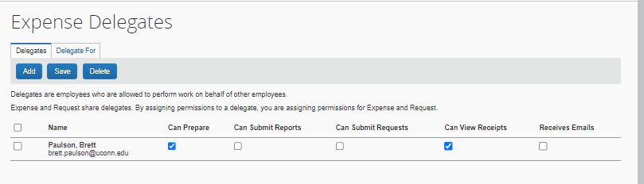
Check your Delegates
Make sure your delegates are set in your Concur Profile:
Profile Settings > Expense Delegates (Under Expense Settings)
If your delegate is not listed, click "Add", search by NetID or Name, select your delegate.
"Can Prepare" and "Can View Receipts" boxes must be checked for the appropriate delegate(s).

Slide 13
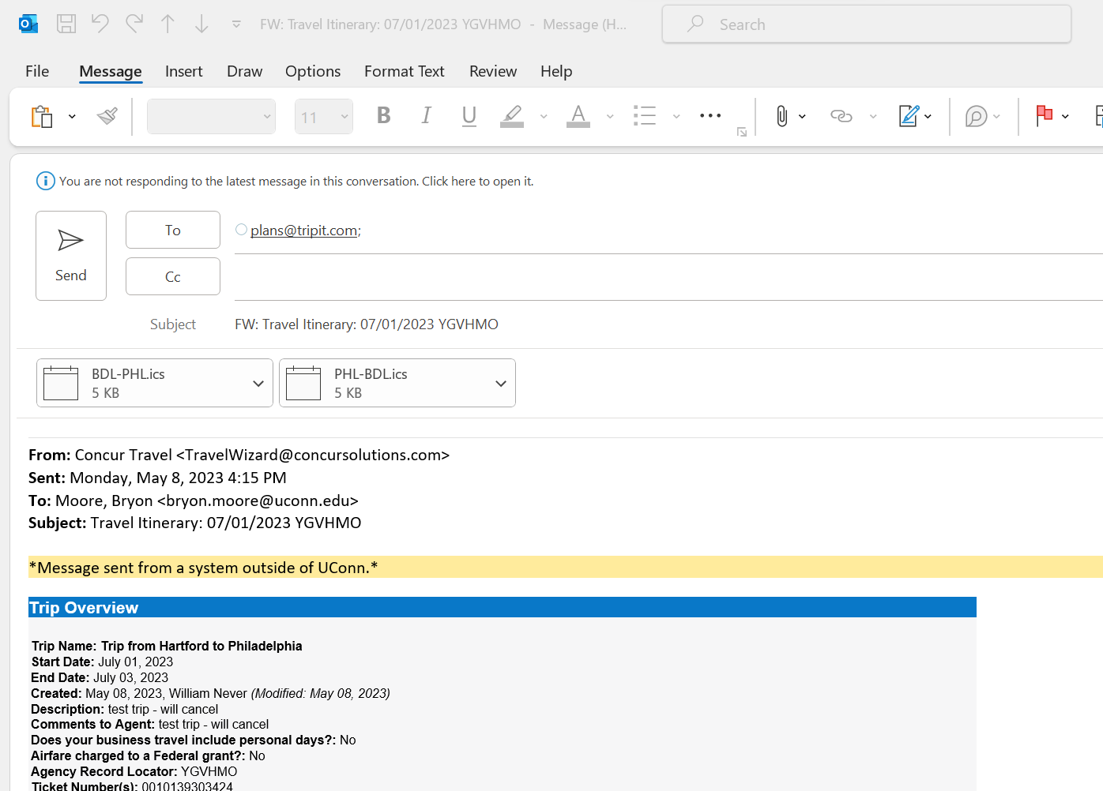
BONUS - Intro to TripIt
Download the TripIt App as an extra resource to assist you with travel. The app can help you with:
Keeping your different trips and segments organized. Flights, Hotels, Car Rentals and Train Tickets.
Tracking your flights. Get warning and alerts about delays and other flight info.
A space to save important travel documents for easy retrieval.
Easy Navigation: Pull up Airport Terminal Maps and other nearby points of interest.
Not just for work: Use TripIt to assist you with personal travel as well. No Concur needed.
*Forward any type of itinerary or confirmation email*

Slide 14
Summary
Today we learned how to:
Download and Login to the Concur Mobile App
Create Expense Reports and Complete the Report Header
Create Expenses via Camera/Camera Roll
Upload Receipts via Email (Traveler & Delegate)
Use ExpenseIT on receipts to Create Expenses
Create Mileage Expenses through the Concur Mobile App
Check Profile Settings for Delegates, Verified Emails and E-Receipts

Slide 15
Links & Contact Info
Forward receipts to receipts@expenseit.com
Email techsupport@uconn.edu for assistance with login, delegates, workflow or functional issues. It is the best way to ensure the entire Financial Systems team is alerted to your issue.
Email travel@uconn.edu for assistance with requests, reports and booking travel.
Visit travel.uconn.edu/training-and-resources/ for the latest training guides and updates
Visit itstatus.uconn.edu/ for the latest updates when Concur is unavailable

