Slide 1
Inclusion by Design: Create an Inclusive and Accessible Experience
Karen Skudlarek, IT Accessibility Coordinator
Chris Cerrigione, Web Designer

Slide 2
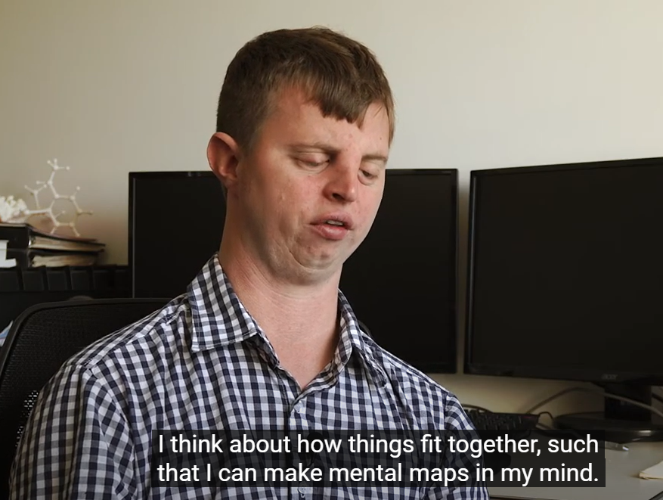
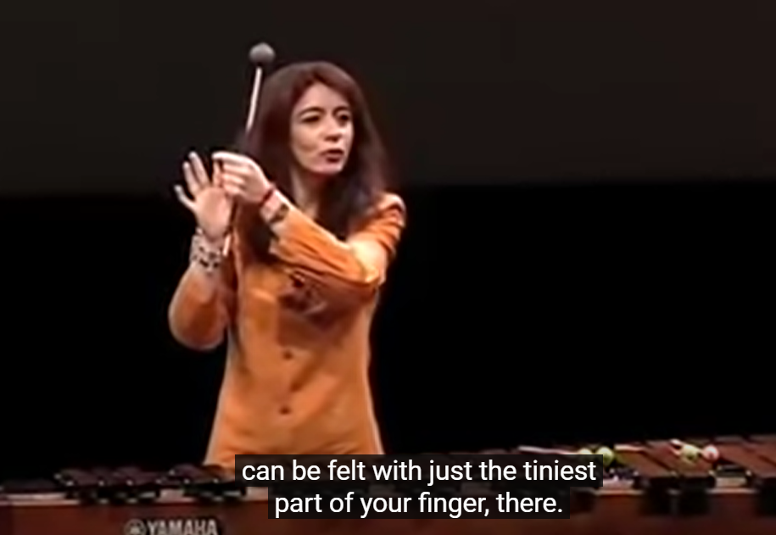
Why Do We Need to Create an Accessible University?
Evelyn Glennie: Percussionist performed with Philharmonic Orchestra
Hoby Wedler: PhD Chemistry UC Davis
Blind at Birth
Deaf at 12 years old

Slide 3
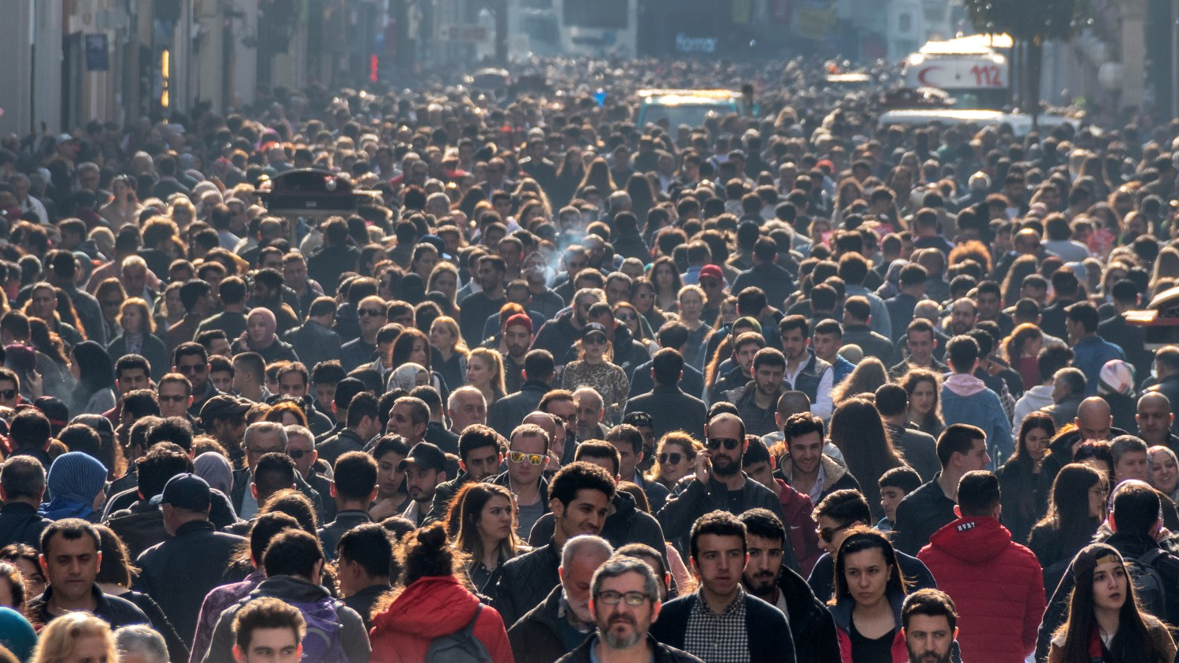
And For Everyone with Varying Abilities

Slide 4
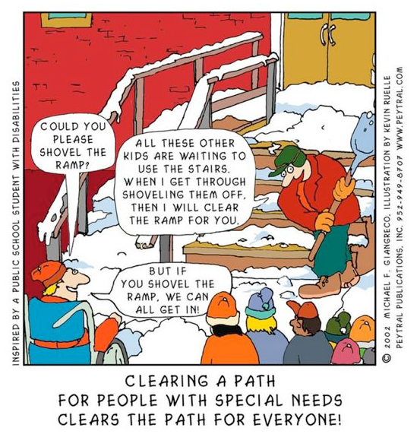
How Do We Create an Accessible University?
Build the ramp first, then build the stairs
Notes:
Source: https://uiowa.instructure.com/courses/40/pages/accessibility-vs-accommodation

Slide 5
Pete Eckert: Blind Photographer

Slide 6
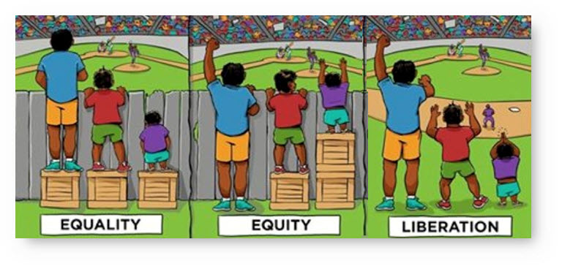
We Create Barriers

Slide 7
What Are Examples of Barriers?

Slide 8
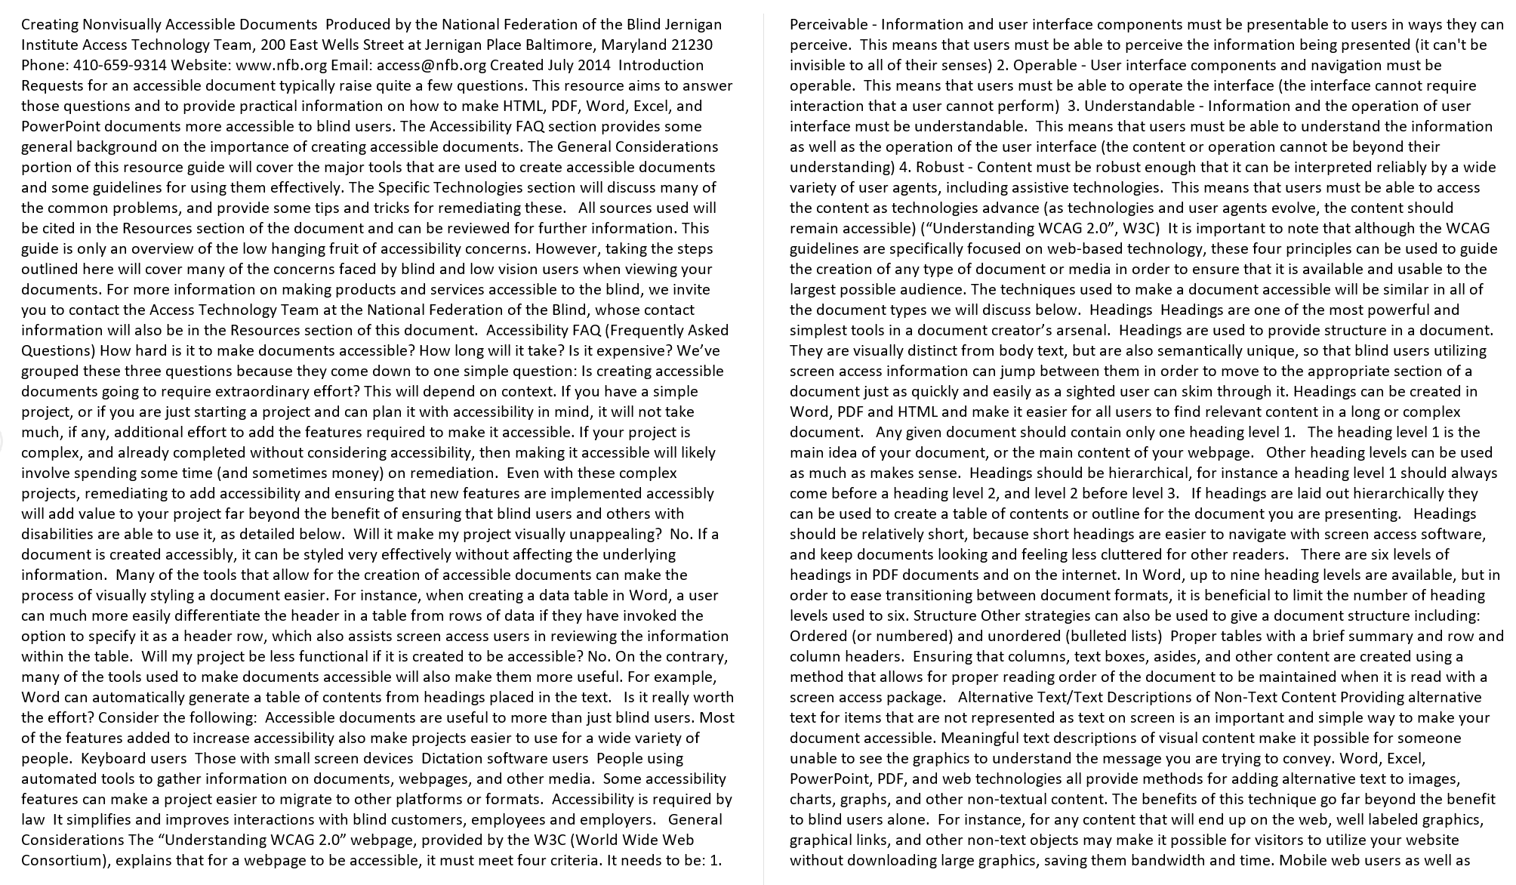
Inaccessible Word Document

Slide 9
Accessible Word Document
Notes:
Creating Nonvisually Accessible Documents: https://www.nfb.org/blog/creating-nonvisually-accessible-documents
The National Center on Disability and Access to Education (NCDAE) exists to address issues of technology and disability in education policies and practices to enhance the lives of people with disabilities and their families. www.ncdae.org

Slide 10
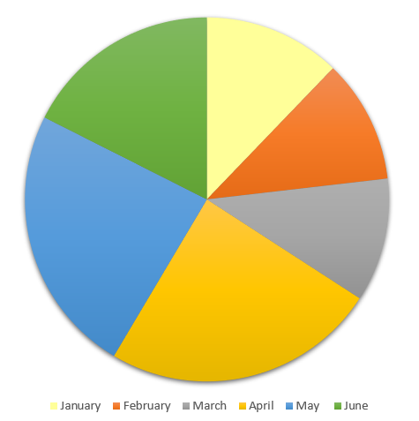
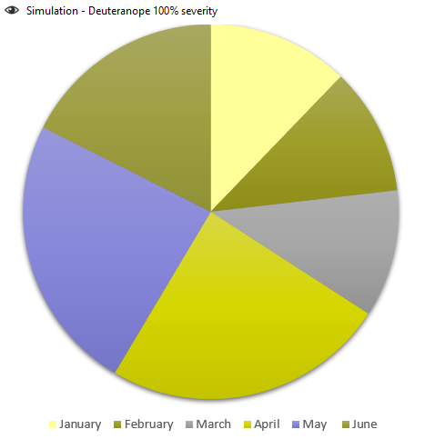
Inaccessible Pie Chart – Red/Green Deficiency

Slide 11
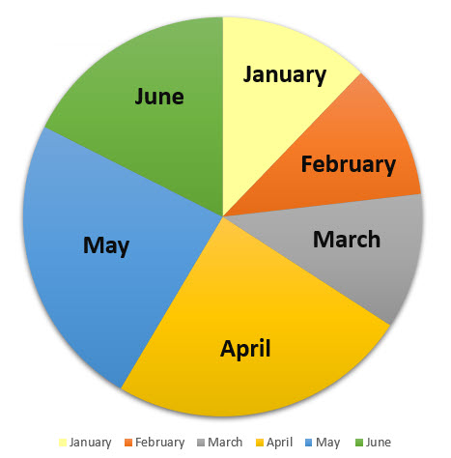
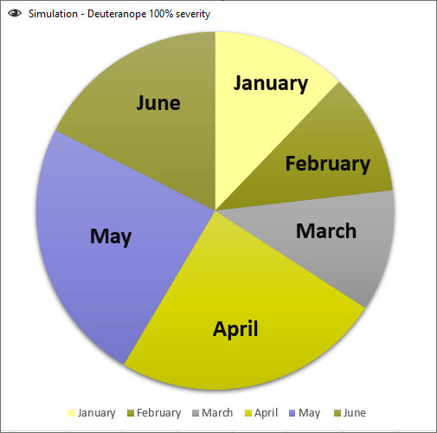
Accessible Pie Chart – Red/Green Deficiency

Slide 12
Inaccessible Links on a Website

Slide 13
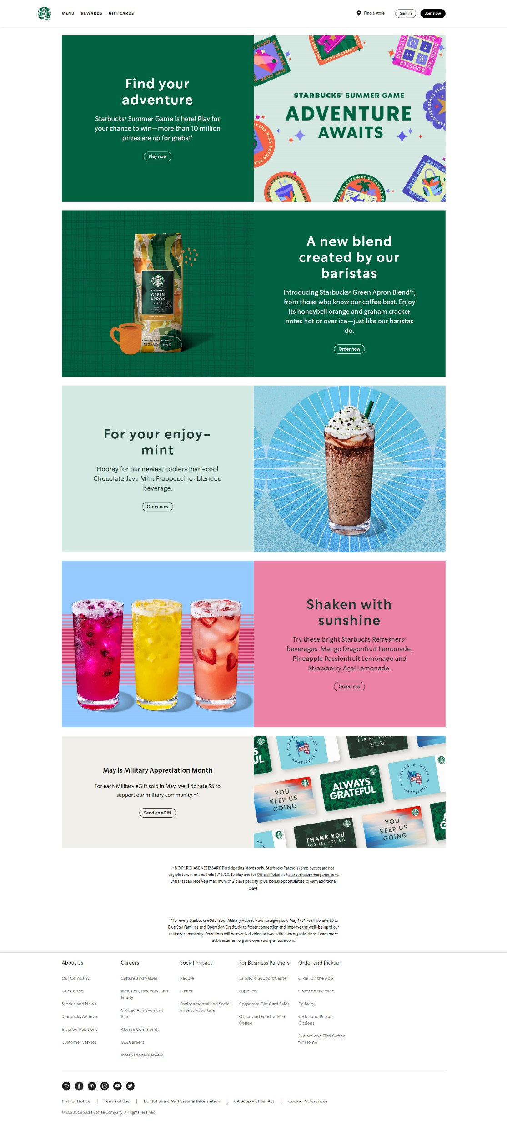
Starbucks Website

Slide 14
Starbucks Links: Starts off okay, but then…

Slide 15
Video Without Captions

Slide 16
Quick Statistics (ages 21-64) Individuals with Disability vs. Individuals without Disability
Bachelor’s Degree or more without disability: 35.2%
Bachelor’s Degree or more with disability: 15.2 %
Employment without disability: 80.0%
Employment with disability: 37.8 %
Source: https://www.disabilitystatistics.org/StatusReports/2018-PDF/2018-StatusReport_US.pdf
Notes:
Erickson, W., Lee, C., & von Schrader, S. (2020). 2018 Disability Status Report: United States. Ithaca, NY: Cornell University Yang-Tan Institute on Employment and Disability(YTI).
https://www.disabilitystatistics.org/StatusReports/2018-PDF/2018-StatusReport_US.pdf

Slide 17
Microsoft Word

Slide 18
Accessible Microsoft Word Documents
Document Title
Accessible Fonts (sans serif)
Arial, Calibri, and Verdana
Headers and Styles
Alt Text
Descriptive Hyperlinks
True Tables
Adequate Color Contrast
Accessibility Checkers
Creating PDFs from Copiers

Slide 19
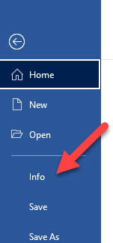
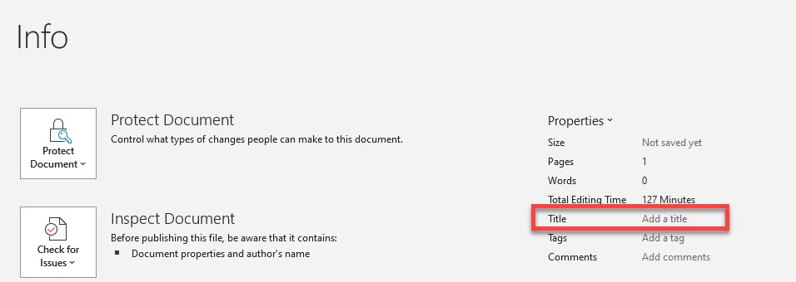
Add Meaningful Title to Document

Slide 20
Accessible Fonts (sans serif)
Good choices are:
Arial
Calibri
Verdana
Try to use font size 12 or higher
Use Strong style for bold and Emphasis style for Italics

Slide 21
Headers and Styles
Tip: Turn on Navigation Pane in Word to see the structure. Click on View in the Ribbon and turn it on under Show section

Slide 22
Headers and Styles in the Ribbon

Slide 23
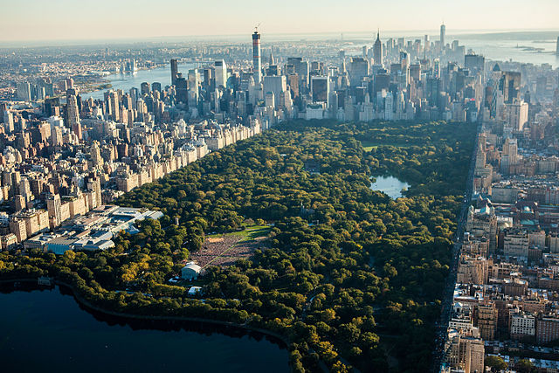
Alt Text
Be precise and concise
Word will automatically generate alt text, this can be turned off in Options > Accessibility > Automatic Alt Text

Slide 24
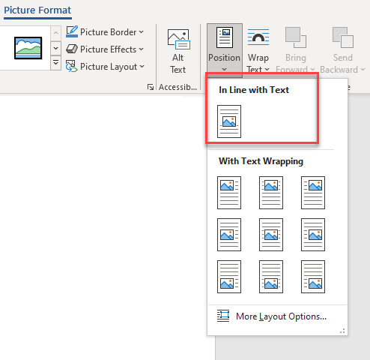
Inserting Pictures
Inserting images, use Position > In Line with Text, floating images may be missed by screen readers

Slide 25
Descriptive Hyperlinks
Screen reader users navigate websites going from link to link
Writing link text
Do not use “click here”
ScreenTip
Will show on screen to sighted users when the link is moused over or tabbed to
Example:
IT Accessibility

Slide 26
True Tables
Use only data for tables
Designate top row as the header for each column
Be sure to turn on Repeat Header Row
Add Alt Text to the Table

Slide 27
True Tables Examples
Inaccessible Table
Karen | Jonathan
(860) 486-0506 | (860) 486-1234
karen.skudlarek@uconn.edu | jonathan.husky@uconn.edu
Accessible Table
Name | Phone Number | Email
Karen | (860) 486-0506 | karen.skudlarek@uconn.edu
Jonathan | (860) 486-1234 | jonathan.husky@uconn.edu

Slide 28
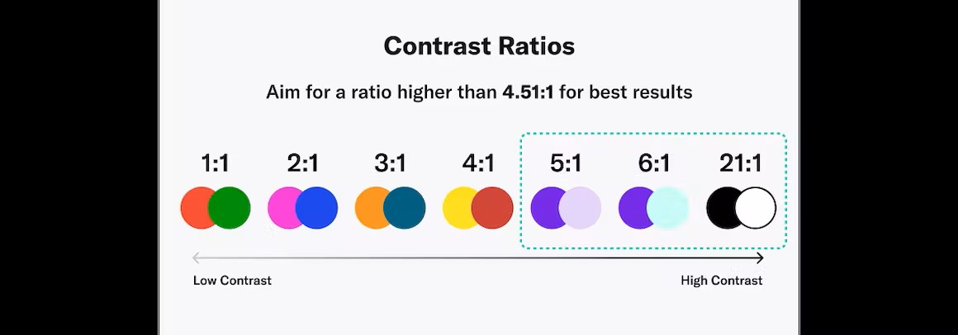
Ensure Proper Color Contrast
Use Colour Contrast Analyser or Color Contrast Pal or WebAIM Website
WCAG Standard: 4.51:1 Ratio
Source: AudioEye

Slide 29
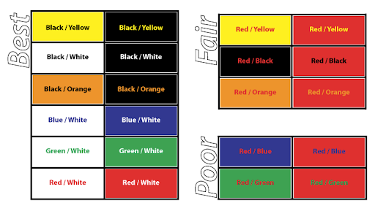
Color Contrast/Visibility Chart
Source: UNCA Office of Academic Accessibility

Slide 30
More About Colors
Do not use color alone to convey meaning
Colors to avoid:
Red and Black (some can’t detect red, and it will appear black)
Red and Green (5% of people cannot distinguish between the two)
Anything with a grey background
This color blindness simulator by Colorblindly will help you understand how different colors appear to people with different types of color blindness.

Slide 31
Office Accessibility Checker
Word includes an accessibility resource that identifies accessibility issues.
Click Review tab on the ribbon > Check Accessibility.
The checker presents accessibility errors, warnings, and tips for making repairs.
Select specific issues to see Additional Information at the bottom of the task pane.

Slide 32
Basic Accessibility Checklist for Word Documents
Document Title
Accessible Font (Arial, Calibri, Verdana)
Use Headers & Styles (turn on Navigation Pane)
Alt Text for Images and Tables
Descriptive Hyperlinks
Use True Tables with Headers (repeat header row)
Adequate color contrast
Use more than color to convey information
Check accessibility with Office and/or Blackboard Ally

Slide 33
Websites

Slide 34
Aurora at UConn - Similarities to Word
When you request a website at UConn, you are provided with a site layout that is accessible but is an empty shell (no content).
As you (content expert) begin to add to the site, keep in mind the following to ensure the site remains accessible (similar to Word):
Website title is meaningful and descriptive
Proper headings – H1, H2, etc.
Alt text on images/diagrams
Descriptive Hyperlinks – No "click here"
Use tables for tabular data only –not for layouts.
Color contrast

Slide 35
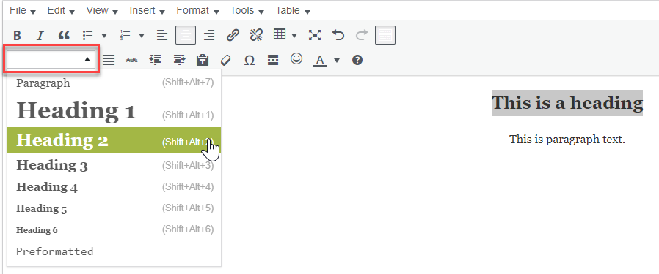
Proper Headings: Website
Visual editor in Aurora- selecting a heading

Slide 36
Aurora at UConn: Website Accessibility
Other specific accessibility requirements for your website:
Skip to Content is available to bypass main menu
The reading and navigation order is logical and intuitive. Use tab and shift-tab to test it.
All page functionality is available using the keyboard
Focus is visible
Keyboard focus is never locked or trapped
Page is readable and functional when the text size is doubled
Use captions and transcripts for video/audio
Add contact information somewhere on the site – recommend footer
Assure documents on site are accessible (i.e. PDF’s & Word)

Slide 37
Blackboard Ally
Tool that you can use to get an accessibility score for your website
Request access by emailing: itaccessibility@uconn.edu
Specify the users
Specify the domains
If you have an organization or class in HuskyCT, you can upload the following filetypes to check accessibility
PDF
DOCX
PPTX

Slide 38
Basic Accessibility Checklist for Websites 1 of 2
Web page title is meaningful and descriptive
Semantic Markup: headers <h1> , special text <strong>
Alt Text for Images and Tables
Descriptive Hyperlinks
Use True Tables with Headers
Adequate color contrast
Check accessibility with Blackboard Ally

Slide 39
Basic Accessibility Checklist for Websites 2 of 2
Skip menus to content is available
Reading and navigation order is logical and intuitive
All page functionality is available using the keyboard
Focus is visible
Keyboard focus is never locked or trapped
Page is readable and functional when text size is doubled
Captions and transcripts for video/audio
Contact information somewhere on the site footer
Assure documents on site are accessible (i.e. PDF’s & Word)

Slide 40
Scan to PDF from UConn Copier
Selecting OCR (Optical Character Recognition) for PDFs created at UConn printers converts typed or printed text into machine-encoded text to be read by a screen reader and searched.
Follow the steps on this Knowledge Base article.

Slide 41
More UConn Resources
ITS Accessibility @ UConn
eCampus Accessible Syllabus Templates
Office of Institutional Equity: Accessibility @ UConn
Center for Students with Disabilities
Questions or to schedule training for your area, please contact us at itaccessibility@uconn.edu

