Slide 1
A guide to Calendaring and Scheduling with Microsoft 365
Presented by
Meera Nair
Notes:
Overview and my introduction

Slide 2
Microsoft 365 Calendaring services
Outlook / Outlook Web App
Scheduling polls
Bookings with me
Notes:
Topics we will be covering today

Slide 3
Calendaring using Outlook / OWA
Most commonly used
Schedule in-person or online meetings
Delegates with permissions can add / remove entries from user calendars
Access calendar from any computer that has internet

Slide 4
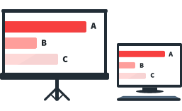
Scheduling Poll
Send multiple time options for meetings
Find availability of users from poll screen
Date picker allows requestor to pick different dates to see availability
Notes:
Has anybody used this feature?

Slide 5
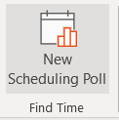
Scheduling Poll settings
Schedule automatically when attendees reach consensus
Hold selected times on my calendar
Notify me about poll updates
Require attendees to verify their identity
Lock poll for attendees

Slide 6
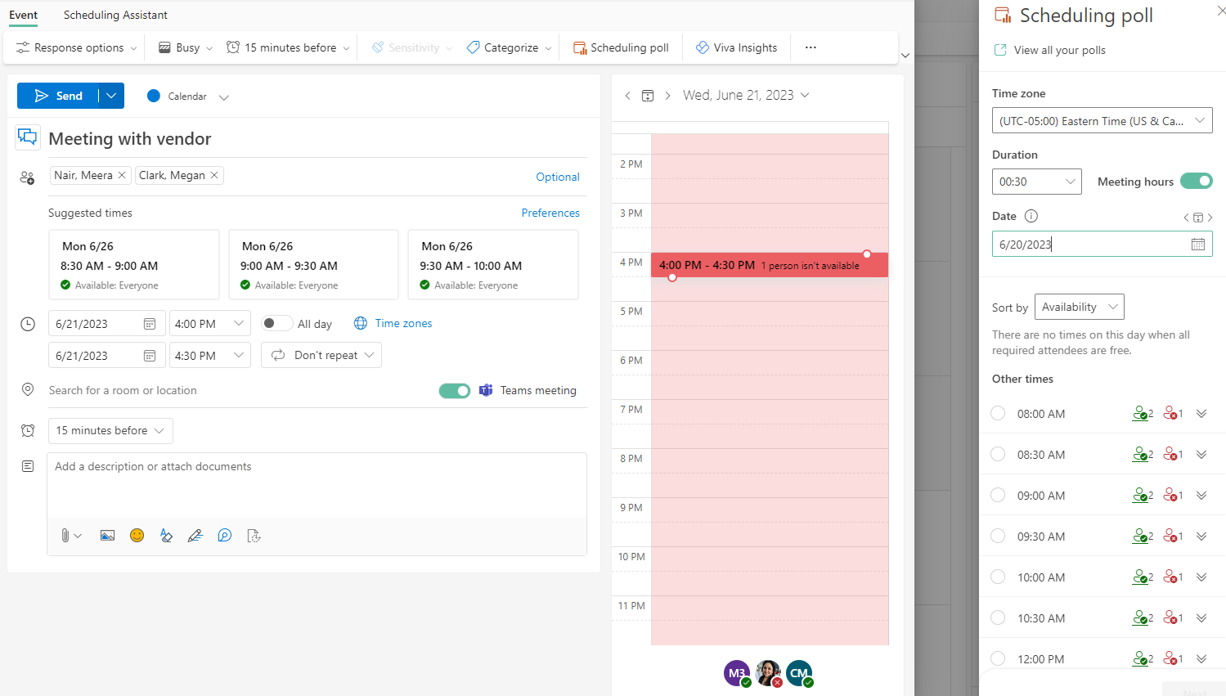
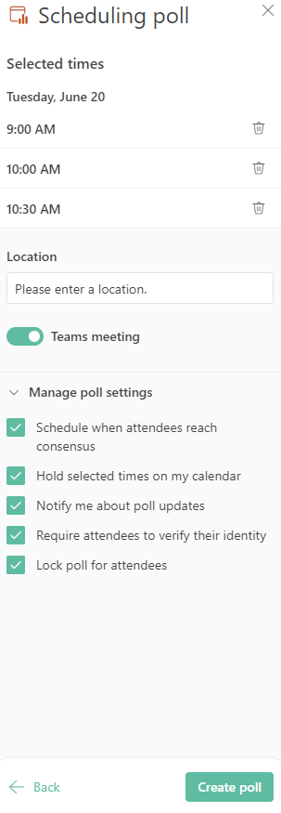
Scheduling Poll Example
Notes:
Mention time zones reflect user set time zone on M365 profile

Slide 7
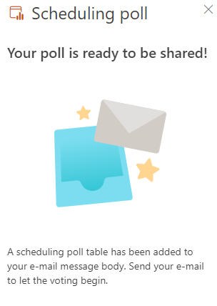
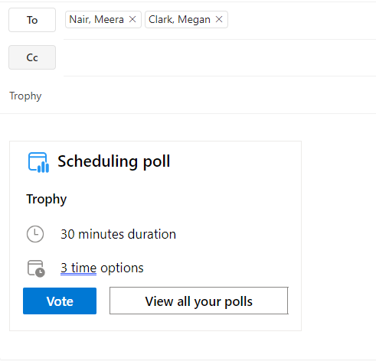
Send meeting with poll info
Once the poll has been created, send the meeting with the poll info

Slide 8
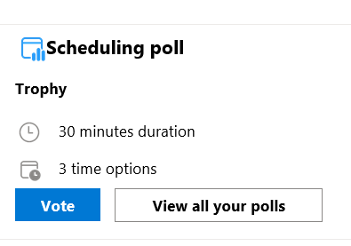
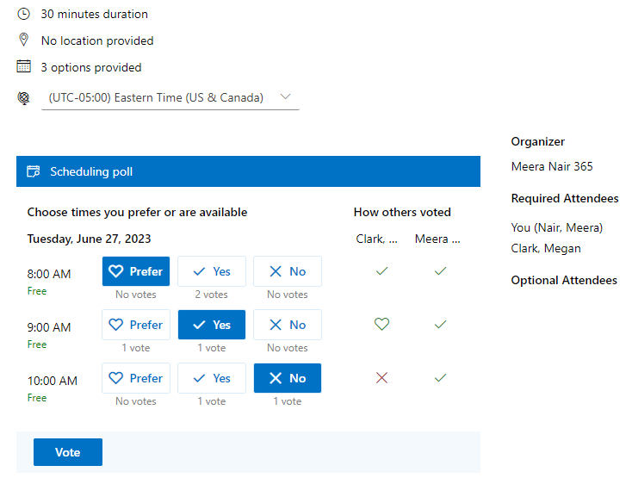
Recipients vote
Recipient receives meeting invite with the poll info:
Recipients can click Vote to open the Poll page from a browser

Slide 9
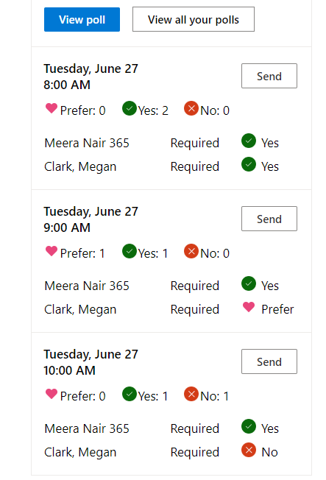
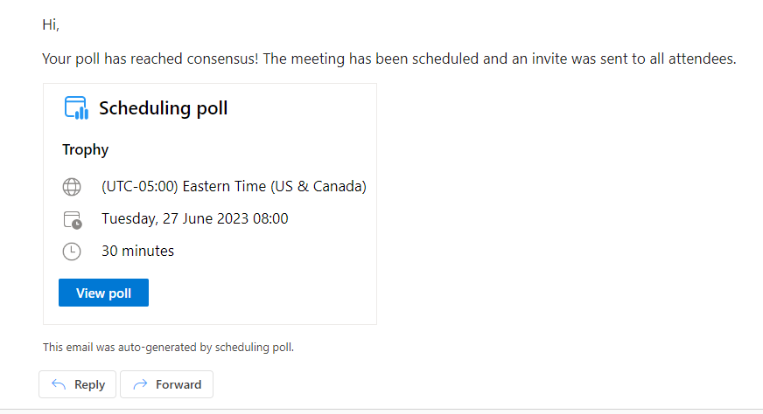
Organizer receives notifications
Organizer receives notifications as specified in the settings page:
Once all the required attendees vote, the poll reaches consensus and schedules meeting:

Slide 10
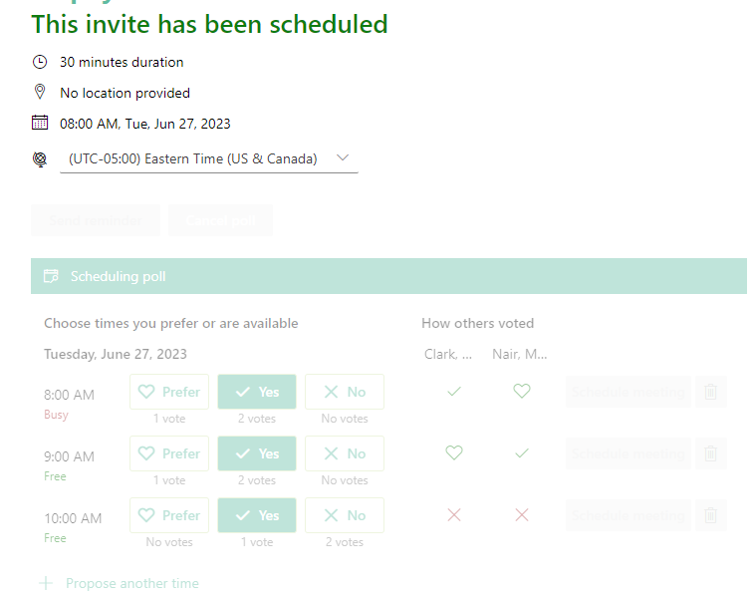
Meeting is scheduled
Navigating to the poll again, indicates that the meeting has been scheduled

Slide 11
Demo of Sharing & Accessing Calendars
Sharing calendars using Outlook
Accessing others calendar from Outlook
Scheduling meeting as delegates from user calendars
Schedule meetings using Scheduling Polls
FindTime Dashboard
Notes:
Mention about “Automation” with scheduling poll to find meeting times for multiple users.
Pause for 1-2 questions after the demo before the next session

Slide 12
Calendaring using Bookings with me
Personal scheduling tool that allows UConn and external users to request time in your calendars through a webpage
Share your BookWithMe link with users via email, Teams or even add it to your email Signature
Requester and meeting owner receives calendar invites just like any other meeting request

Slide 13
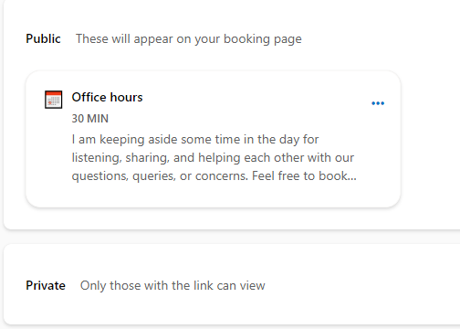
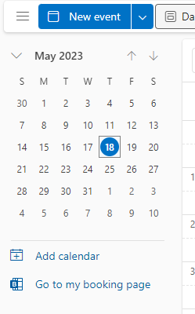
Office Hours
From OWA, Navigate to Outlook → Calendar → Go to my booking page
“Office hours” is a default booking page that has been created for you.
Notes:
Nexus.uconn.edu

Slide 14
Customize booking with me page
Select from Public or Private pages
Public : Links can be made publicly available on a webpage or send direct links to users
Private: Only users that have direct link from you can open or schedule. This includes “Copy single-use link”

Slide 15
Demo of Booking with me
Schedule booking
Email notifications for meetings scheduled
Calendar entries to block time from your calendar

Slide 16
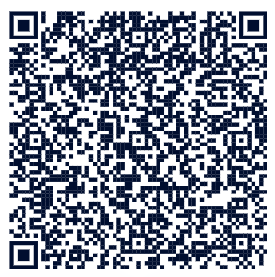
Try it out !!!

Slide 17
Customize bookings with me page
Meeting hours: Indicate the hours during which the meeting can be scheduled
Buffer before meeting: Duration that remains unbooked prior to meeting start time
Buffer time after: Post-meeting time that remains unbooked
Minimum lead time: Booking must be done at least specified time in advance
Maximum lead time: Booking must be done within this number of days before meeting time
Notes:
Review of what was covered during demo

Slide 18
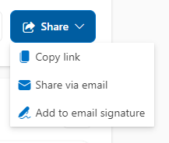
Share your page
Share button:
Copy link to your entire booking page or to the specific booking for easy sharing
Share via email
Add to email signature adds the Bookings page link to your signature
Notes:
Review of what was covered during demo

Slide 19
More information in our Knowledgebase
kb.uconn.edu/space/IKB/10726900298/Calendar
Email: techsupport@uconn.edu
Web: techsupport.uconn.edu
Call: 860-486-4357
Notes:
I cannot answer all your questions at this point..

Slide 20
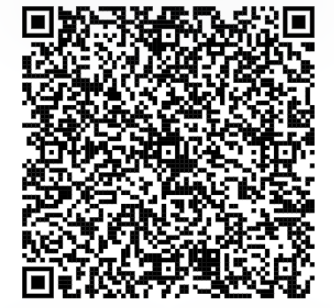
Feedback
Please fill out this form when you have a chance.

