Slide 1
Microsoft Forms
Making data collection quick and easy
Joshua Z. Jones

Slide 2
MS Forms Progression
Initial Release: June 20, 2016
Initially only available with Office 365 for Education
Now available under many Microsoft 365 licenses and everyone at UConn
Integrates with several Microsoft services including
  Teams
  Power Automate

Slide 3
MS Forms vs. Kuali Build
Kuali Build
MS Forms
Simple data collection
Single use-cases
Small interdepartmental operations
Workflow capabilities
Pulling info from different systems
Extensive approval processes
Send back to submitter for changes if necessary

Slide 4
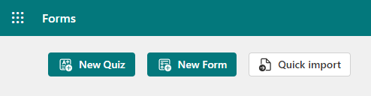
New Home Page & Features
https://forms.office.com
Quizzes
Forms
Import from Word Doc or PDF

Slide 5
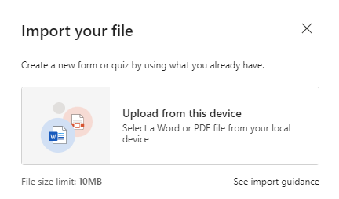
Import Demo

Slide 6
Common Use-Cases
Surveys
RSVP to events
Luncheon menus
Interest gathering
Personal performance tracking

Slide 7

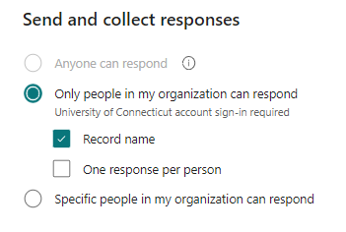
Collecting Responses
Anonymous (anyone)
All UConn Members
Select UConn Members

Slide 8
Branching / Demo

Slide 9
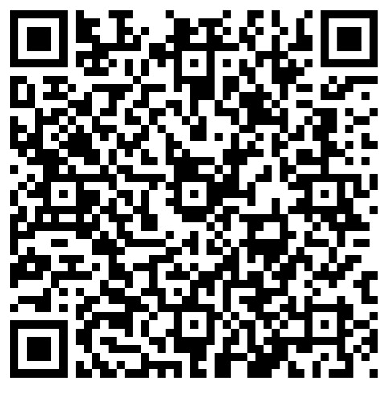
Scan Me!

Slide 10
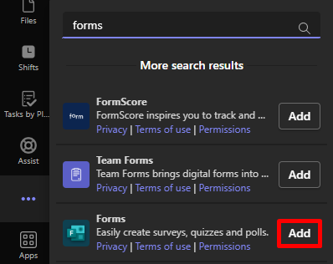
Teams Integration Demo

Slide 11
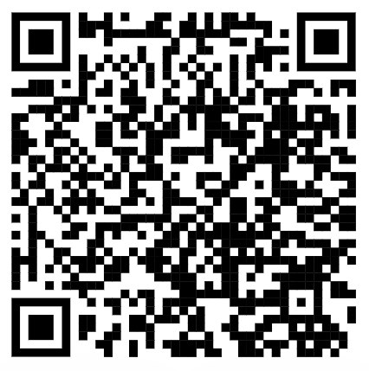
Questions?
Email & Teams: JZJ@uconn.edu
Kuali Build Questions?
Email: techsupport@uconn.edu
Web: techsupport.uconn.edu
Call: 860-486-4357
MS Forms KB Articles

