Slide 1
Cyber Safety & Security
You Can Wear Your Hat(s)…in the Cloud(s)
Laurie Neal, Information Security
Notes:
Hello everyone, thank you so much for being here today for Staff Technology Day. My name is Laurie Neal, and I am an Information Security Awareness Specialist here in ITS. Security may be part of my title, but I’m here to convince you that you also practice Cyber Security as part of your role, as well as cyber safety. We all play a play a part in keeping UConn safe and secure.
Safety and security may sound similar but I’m going to break down what I mean, and help explain what hat you are wearing and when, and also highlight some special strategies in Microsoft 365. Applies to personal life as well.
Before we dive in, I’m hoping to make this session engaging. Please have your phone out and ready. We’ll have polls activated by a QR code. It’s completely anonymous. There will be some no tech engagement opportunities as well. This presentation will be available to you online, so do not feel as though you need to frantically take notes.
Let’s get started with a big step back.

Slide 2
10,000 Foot View
≈ 30,000 Students
≈ 250,000 Alumni
≈ 10,000 Employees
Patients
Research Participants
Visitors
Notes:
We have a lot going on at UConn. 30,000+ students, 250,000+ alumni, about 10,000 employees, patients, research participants, and plenty of visitors.

Slide 3
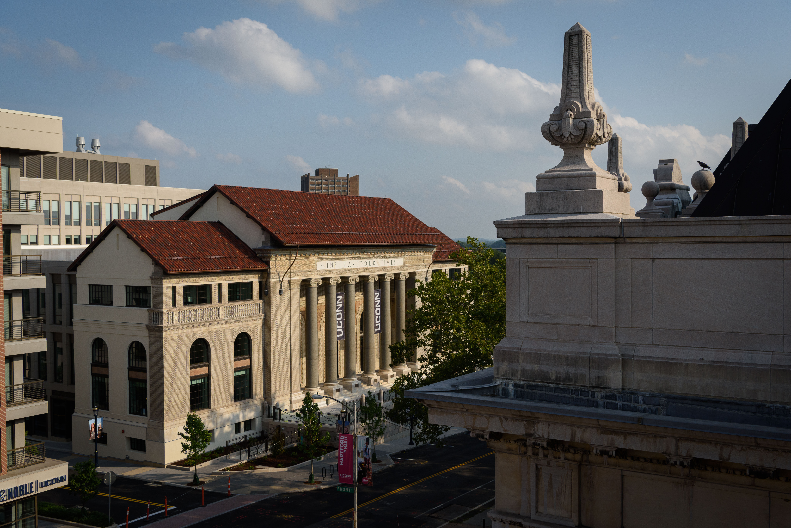
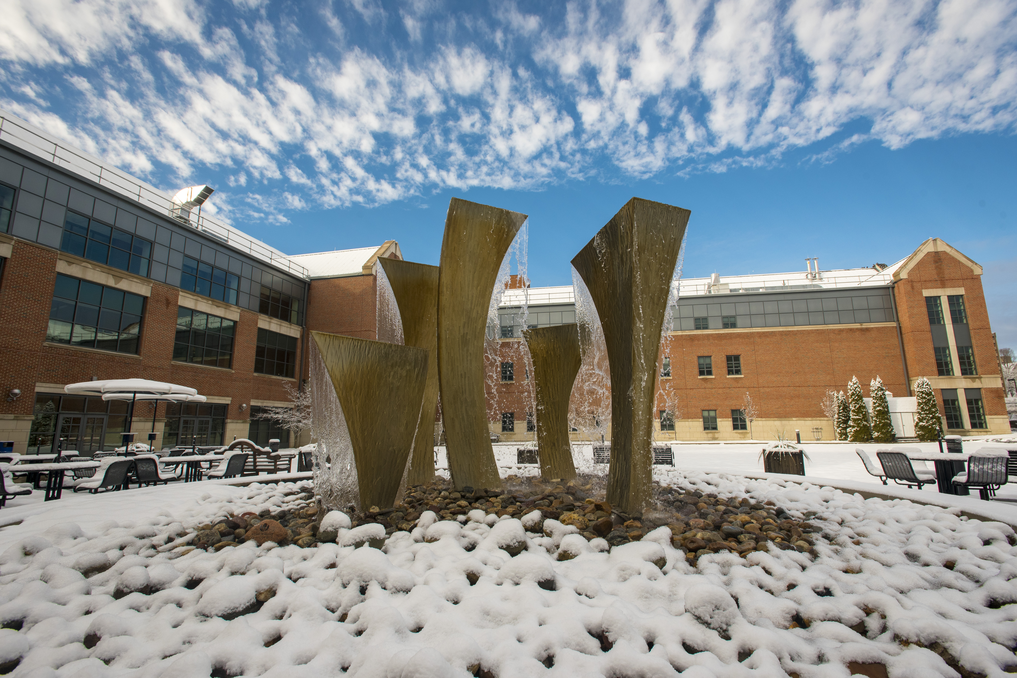
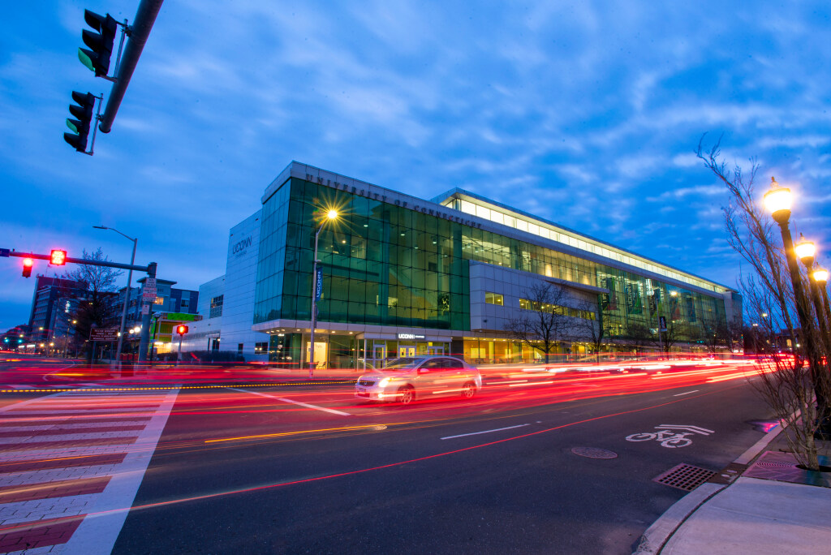
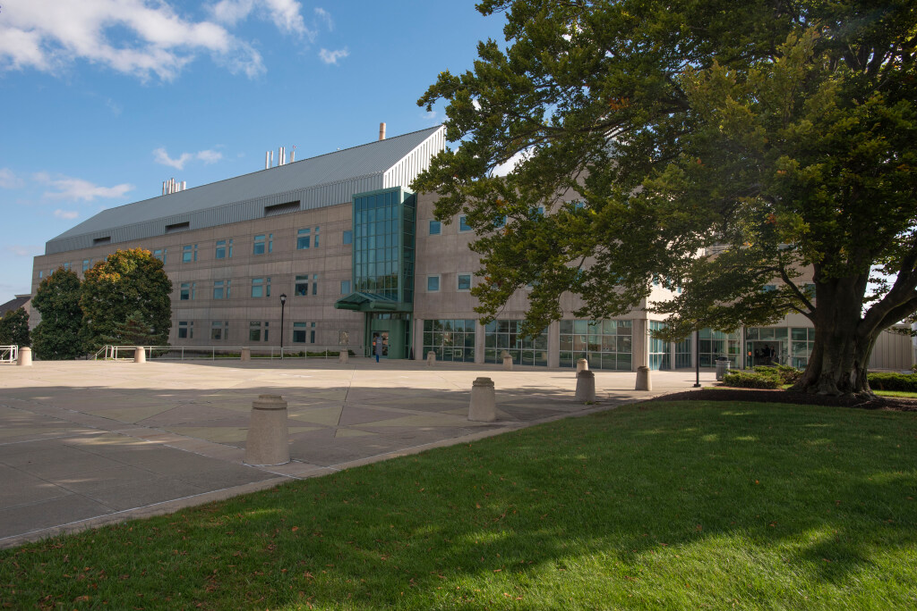
A Closer View
Lots of assets
Personal info
Proprietary info
Notes:
We have a lot of assets at UConn. We have beautiful campuses, buildings, equipment, technology and systems. Information we store… is also an asset. And much of it including personal and proprietary information.

Slide 4
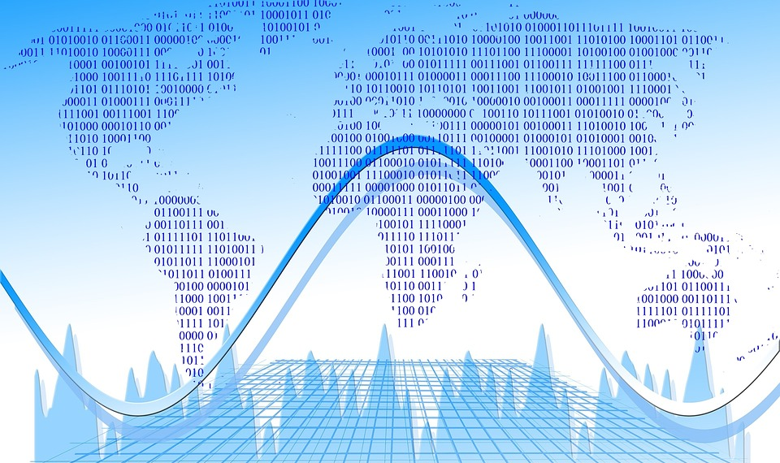
UConn is Far Reaching
State presence
National presence
Global presence
Sharing knowledge is core to our mission!
Sharing information is core to supporting our mission!
Notes:
UConn’s presence is far reaching across the state, the nation and the world. And sharing knowledge is core to our mission. But sharing information is core to supporting our mission. As information is an asset, we must treat this information with care.

Slide 5
UConn Information
Public
Protected
Guarded
Confidential
Limited disclosure governed by law, regulation, contracts, university policies…
Data Classification Policy
policy.uconn.edu
Notes:
What information am I talking about?
Data Classification Definitions (policy).
Public- readily available information
Protected- Not readily available, but in some circumstances can be.
Confidential- Very limited disclosure, and in accordance with rules.
Analogy to campus buildings- you have your public spaces that anyone can pretty much show up to. You have your protected spaces that require controlled access, but generally accessible to the community (badging/identification verification), confidential spaces- very limited access need only basis.
Example- student records are generally confidential, and may be disclosed with consent, or by exceptions to prior written consent.
This example, illustrates that we need to safeguard information.

Slide 6
Safety Definition
the condition of being protected from or unlikely to cause danger, risk, or injury.
Practice safety to reduce the risk of harm.
Notes:
Why do we practice safety?
Experiencing danger, risk, injury leads to harm…
We want to reduce the likelihood of harm.

Slide 7
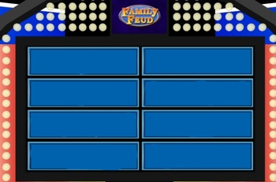
What Actions Keep Us Safe?
Shout it out!
Wash hands
Buckle seat belt
Wear bike helmet
Lock your bike/car
Let coffee cool
Notes:
Let’s do a mindfulness exercise. What are the things you did today to help stay protected from harm? What safety precautions do you practice in everyday life. Shout it out!
We learned this at some point even if it has become something we do without even thinking about it. Because if we don’t, it can lead to danger, risk, injury.
Same is true for practicing cyber safety… those people in our neighborhood. We have a lot of information. Not just about personal data… sensitive research activities…. Threats that
Reduces the likelihood of harm… minize the chance of you being seriously harm. Minimize adverse. Highlight risk.. Family Feud… Survey Says…
In other words we have to do “Safeguarding”.. You have your own version of this!!!
What are the things you did today to help stay protected from harm? What safety precautions do you practice in everyday life. Shout it out! Do you remember specifically when you learned this, but somehow it became common practice for you.
Let my coffee cool down.
We learned this at some point even if it has become something we do without even thinking about it. Because if we don’t, it can lead to danger, risk, injury.
Same is true for practicing cyber safety… those people in our neighborhood. We have a lot of information. Not just about personal data… sensitive research activities…. Threats that

Slide 8
Why and How?
Why do we do this?
Do we give much thought?
Notes:
We do it to reduce the likelihood of harm.
Do you remember specifically when you learned this, but somehow it became common practice for you.

Slide 9
Safety Practices
Stem from complying with:
Best practice
Known standard
Policy/regulation
Becomes habit…
Notes:
What are the things you did today to help stay protected from harm? What safety precautions do you practice in everyday life. Shout it out! Do you remember specifically when you learned this, but somehow it became common practice for you.
Let my coffee cool down.
We learned this at some point even if it has become something we do without even thinking about it. Because if we don’t, it can lead to danger, risk, injury.
Same is true for practicing cyber safety… those people in our neighborhood. We have a lot of information. Not just about personal data… sensitive research activities…. Threats that

Slide 10
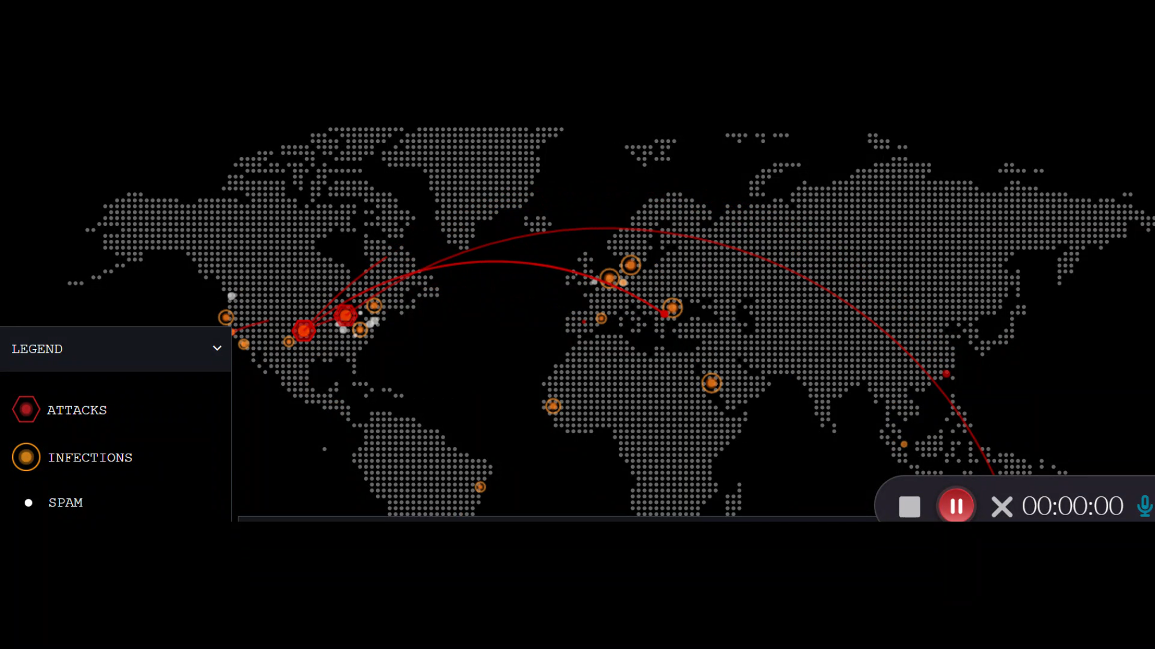
Why Cyber Safety?
Notes:
What are the things you did today to help stay protected from harm? What safety precautions do you practice in everyday life. Shout it out! Do you remember specifically when you learned this, but somehow it became common practice for you.
Let my coffee cool down.
We learned this at some point even if it has become something we do without even thinking about it. Because if we don’t, it can lead to danger, risk, injury.
Same is true for practicing cyber safety… those people in our neighborhood. We have a lot of information. Not just about personal data… sensitive research activities…. Threats that

Slide 11
Global Cyber Attack Map
Notes:
https://threatmap.bitdefender.com/

Slide 12
Potential Harmful Outcomes
Data Subjects
Financial
Emotional
Physical
Institutional
Financial
Reputational
Loss of Proprietary Info
Help prevent harm with cyber safety practices!

Slide 13
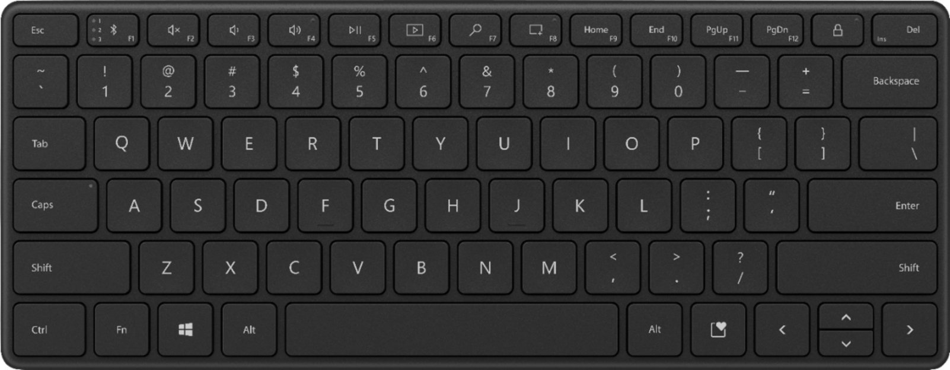
Lock Screen on Windows
L
Notes:
What are the things you did today to help stay protected from harm? What safety precautions do you practice in everyday life. Shout it out! Do you remember specifically when you learned this, but somehow it became common practice for you.
Let my coffee cool down.
We learned this at some point even if it has become something we do without even thinking about it. Because if we don’t, it can lead to danger, risk, injury.
Same is true for practicing cyber safety… those people in our neighborhood. We have a lot of information. Not just about personal data… sensitive research activities…. Threats that

Slide 14
Lock Screen on Apple
^ ⌘ Q
Notes:
What are the things you did today to help stay protected from harm? What safety precautions do you practice in everyday life. Shout it out! Do you remember specifically when you learned this, but somehow it became common practice for you.
Ctrl. Command que.
Let my coffee cool down.
We learned this at some point even if it has become something we do without even thinking about it. Because if we don’t, it can lead to danger, risk, injury.
Same is true for practicing cyber safety… those people in our neighborhood. We have a lot of information. Not just about personal data… sensitive research activities…. Threats that

Slide 15
Authentication Tips
Long “Passphrases”
Password Managers
Phone Locks
Multifactor Authentication
Notes:
Don’t use common dates- go to Dustin’s presentation.
Multifactor is nothing new- do you use a pin code when you withdraw money from an ATM. That is MFA!

Slide 16
Authentication Tips cont.
Long “Passphrases”
Password Managers
Phone Locks
Multifactor Authentication
“A string of words that must be used to gain access to a computer system or service.”
Notes:
What are the things you did today to help stay protected from harm? What safety precautions do you practice in everyday life. Shout it out! Do you remember specifically when you learned this, but somehow it became common practice for you.
Let my coffee cool down.
We learned this at some point even if it has become something we do without even thinking about it. Because if we don’t, it can lead to danger, risk, injury.
Same is true for practicing cyber safety… those people in our neighborhood. We have a lot of information. Not just about personal data… sensitive research activities…. Threats that

Slide 17
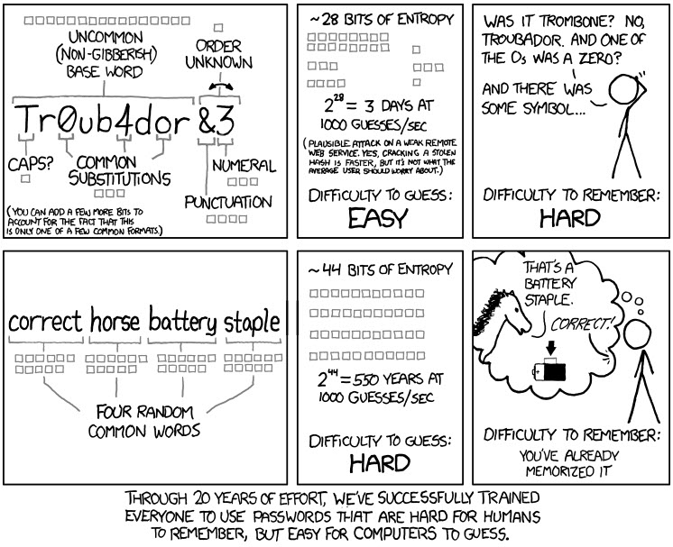
Passphrases
Passphrases= Easier & Stronger!
Notes:
If your UConn password is less than 12 characters, change it. If it has been years since you updated your password, change it.

Slide 18
Software Updates
Accept your Software Updates!
Includes security patches.
Be proactive (or get stuck).
Notes:
What are the things you did today to help stay protected from harm? What safety precautions do you practice in everyday life. Shout it out! Do you remember specifically when you learned this, but somehow it became common practice for you.
Let my coffee cool down.
We learned this at some point even if it has become something we do without even thinking about it. Because if we don’t, it can lead to danger, risk, injury.
Same is true for practicing cyber safety… those people in our neighborhood. We have a lot of information. Not just about personal data… sensitive research activities…. Threats that
Updating things that don’t prompt you..

Slide 19
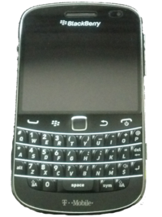
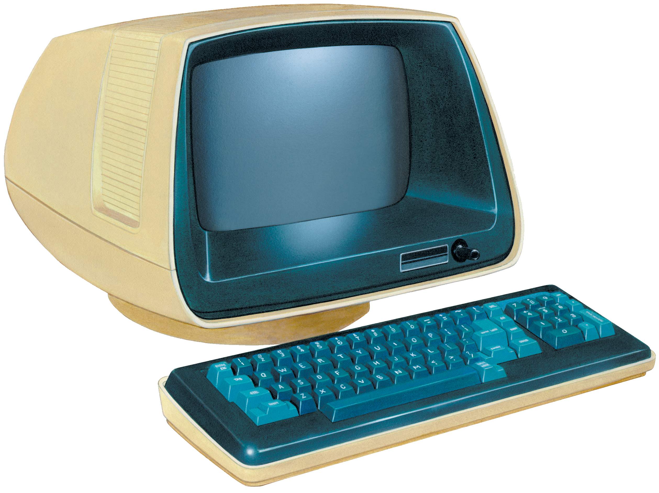
More Software/Hardware
Don’t forget the unprompted.
Retire old hardware.
Personal devices no longer supported….
Notes:
What are the things you did today to help stay protected from harm? What safety precautions do you practice in everyday life. Shout it out! Do you remember specifically when you learned this, but somehow it became common practice for you.
May still work but not the best idea.
We learned this at some point even if it has become something we do without even thinking about it. Because if we don’t, it can lead to danger, risk, injury.
Same is true for practicing cyber safety… those people in our neighborhood. We have a lot of information. Not just about personal data… sensitive research activities…. Threats that
Updating things that don’t prompt you..

Slide 20
Social Engineering
The use of deception to manipulate individuals into divulging confidential or personal information that may be used for fraudulent purposes.
Notes:
What are the things you did today to help stay protected from harm? What safety precautions do you practice in everyday life. Shout it out! Do you remember specifically when you learned this, but somehow it became common practice for you.
Let my coffee cool down.
We learned this at some point even if it has become something we do without even thinking about it. Because if we don’t, it can lead to danger, risk, injury.
Same is true for practicing cyber safety… those people in our neighborhood. We have a lot of information. Not just about personal data… sensitive research activities…. Threats that

Slide 21
And then along came Phishing…
Phishing is the #1 Crime
~FBI, 2022 Internet Crime Report
Think Before You Click.
Notes:
Phishing also leads to other ones that are on that list.

Slide 22
Phishing Flags
Urgent requests. Phishing attacks attempt to induce panic.
Generic signature line. A university message is typically signed by a university official, whose name you can verify.
Unexpected requests regarding personal information. Be wary of clicking links from contacts you did not initiate.
Incorrect domain (@uconn.com)*
Notes:
Spoofing- everyday emails in personal life.

Slide 23
Phishing Exercise
Phishing hints?
Notes:
Snippets of examples. UConn.com- what’s wrong with these domains? Examples in JIRA- here is what this looks like.
After examples, habit is pausing, not just clicking forward.
Rushed, Multitask, stressed- emotional aspect. Tie it together based on real feedback.

Slide 24
Report Concerns
Suspected phishing emails
reportphishing@uconn.edu
Password/system compromise
techsupport@uconn.edu
Netid.uconn.edu
If defrauded… contact police.
Notes:
Give examples- students have lost money.

Slide 25
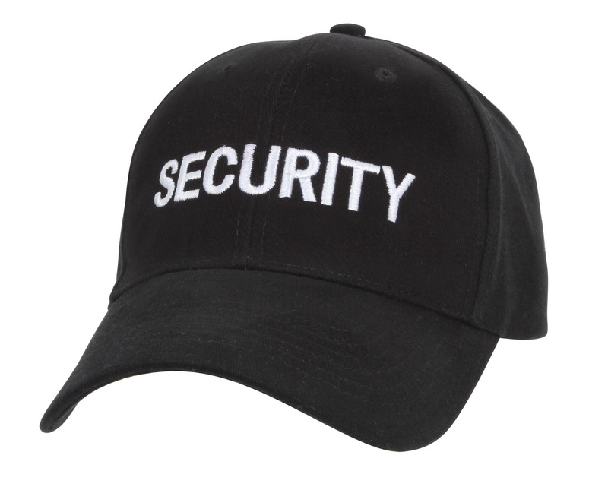
What Hat?
Cyber Safety
Complying
Habits, Some Thought
Follow
Cyber Security
Applying
Critical Thinking
Lead
Notes:
What are the things you did today to help stay protected from harm? What safety precautions do you practice in everyday life. Shout it out! Do you remember specifically when you learned this, but somehow it became common practice for you.
Let my coffee cool down.
We learned this at some point even if it has become something we do without even thinking about it. Because if we don’t, it can lead to danger, risk, injury.
Same is true for practicing cyber safety… those people in our neighborhood. We have a lot of information. Not just about personal data… sensitive research activities…. Threats that

Slide 26
Security Definition
procedures followed or measures taken to ensure the safety of a state or organization.
all the measures that are taken to protect a place, or to ensure that only people with permission enter it or leave it.
Enforce security to reduce the risk of harm.
Notes:
Why do we practice safety?
Experiencing danger, risk, injury leads to harm…
We want to reduce the likelihood of harm.
Chatgpt summarize definitions together. Define security in relation to protecting information.

Slide 27
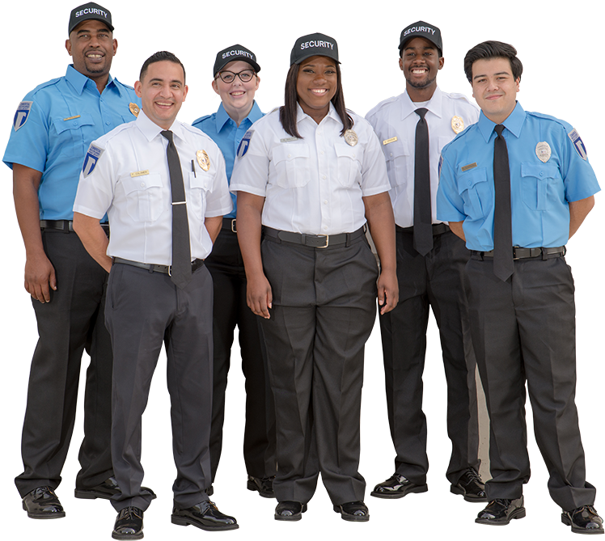
Security Practices
Take thought…
Stem from applying:
Technical controls
Known standard
Policy/regulation
Notes:
What are the things you did today to help stay protected from harm? What safety precautions do you practice in everyday life. Shout it out! Do you remember specifically when you learned this, but somehow it became common practice for you.
Let my coffee cool down.
We learned this at some point even if it has become something we do without even thinking about it. Because if we don’t, it can lead to danger, risk, injury.
Same is true for practicing cyber safety… those people in our neighborhood. We have a lot of information. Not just about personal data… sensitive research activities…. Threats that

Slide 28
Revisiting UConn Information
Protected
Guarded
Confidential
Limited disclosure governed by law, regulation, contracts, university policies…
Data Classification Policy
policy.uconn.edu
Notes:
In other words we have to do “Safeguarding”
Matrix for data types. Use examples for first slide.

Slide 29
Understand Information Lifecycle
Records Lifecycle
Creation/ Receipt
Distribution
Use
Disposition
Notes:
What are we trying to Secure?
Securing Records and Information…
We need to understand the Record Lifecycle. Secure proper management of information of lifecycle.
If it exists- needs to be managed.
If it doesn’t….

Slide 30
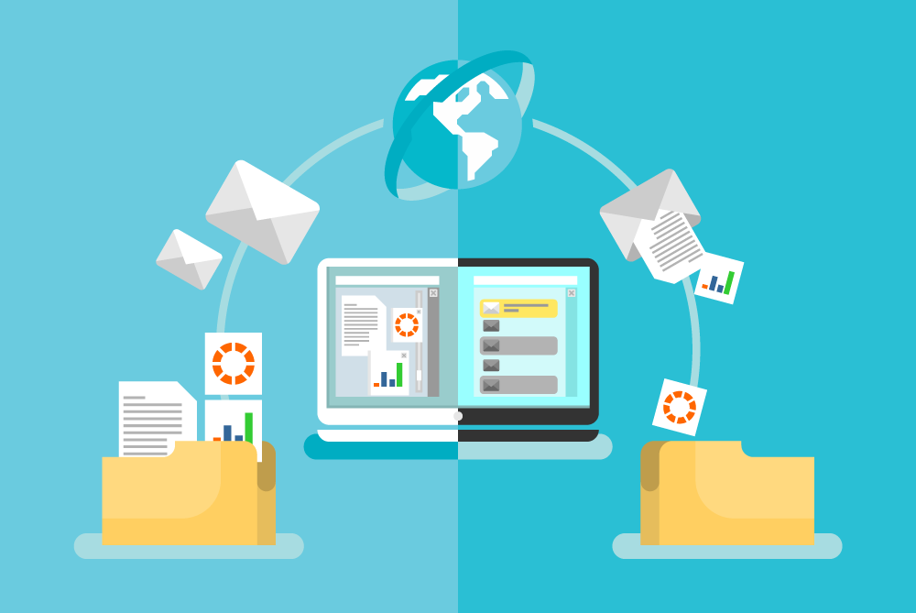
Securing Information
You apply security by managing information (and the access to it)!

Slide 31
Managing Access to Information
Microsoft 365 Shares
Student Work Accounts
Final Disposition

Slide 32
Managing Access to Information 2
Microsoft 365 Shares
Student Work Accounts
Final Disposition

Slide 33
Microsoft 365 Shares
Notes:
Share Responsibly. Revoke when necessary.

Slide 34
Microsoft 365 Notification

Slide 35
Microsoft 365 Shares Heading

Slide 36
Microsoft 365 Shares Email Body

Slide 37
Other Microsoft 365 Sharing
Externally (with password)
Request upload
[Encrypt] (in transit)*
Notes:
Encrypt function-
Subject Line [Encrypt]
*KB article
Benefits?
Cut off access…
Audit Logs…

Slide 38
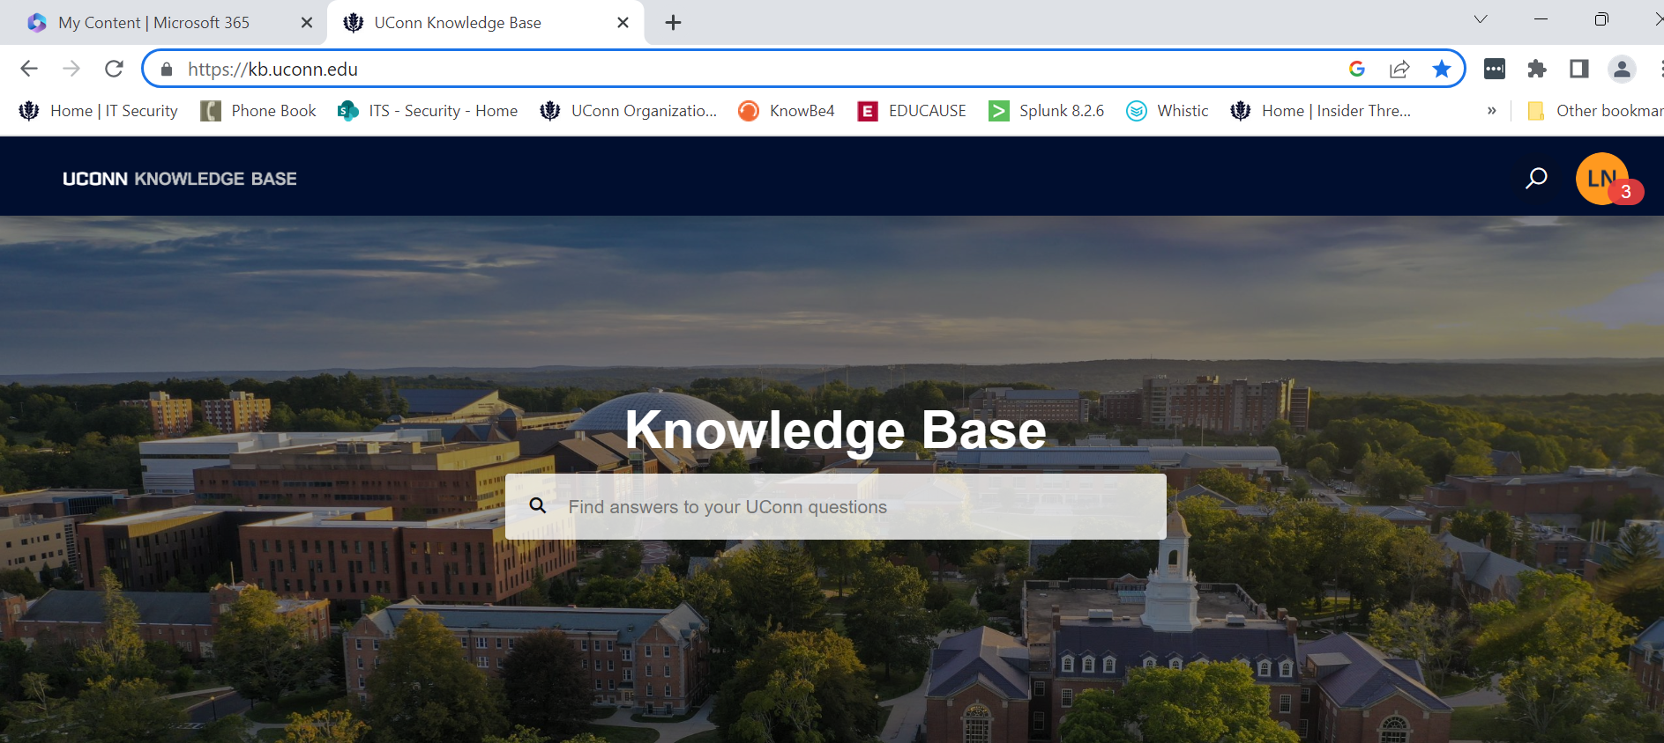
Knowledge Base Resource
Visit…
kb.uconn.edu

Slide 39
Managing Access to Information 3
Microsoft 365 Shares
Student Work Accounts
Final Disposition

Slide 40
Managing Access to Information 4
Microsoft 365 Shares
Student Work Accounts
Final Disposition
Let’s take a couple polls!

Slide 41
Interactive Live Training Poll
I work regularly with student workers in my department.
ⓘ Start presenting to display the poll results on this slide.
Notes:
FIX

Slide 42
Interactive Live Training Poll cont.
Our students have work accounts (e.g. lan09004work)
ⓘ Start presenting to display the poll results on this slide.

Slide 43
Student Work Account: Why?
Access to Microsoft 365 apps
Separation from work account/school account (e.g. email)
Easy access removal upon separation from employment
Notes:
What are the things you did today to help stay protected from harm? What safety precautions do you practice in everyday life. Shout it out! Do you remember specifically when you learned this, but somehow it became common practice for you.
Report when student separates from employment- access will get cut off.
What happens if they change department?
We learned this at some point even if it has become something we do without even thinking about it. Because if we don’t, it can lead to danger, risk, injury.
Same is true for practicing cyber safety… those people in our neighborhood. We have a lot of information. Not just about personal data… sensitive research activities…. Threats that

Slide 44
Student Work Account: How?
Go to NetID.uconn.edu
Log in
Click Account Sponsorship Tab
Scroll to Student NetID Work Accounts
Enter Student Information & Submit
Notes:
What are the things you did today to help stay protected from harm? What safety precautions do you practice in everyday life. Shout it out! Do you remember specifically when you learned this, but somehow it became common practice for you.
Report when student separates from employment- access will get cut off.
What happens if they change department?
We learned this at some point even if it has become something we do without even thinking about it. Because if we don’t, it can lead to danger, risk, injury.
Same is true for practicing cyber safety… those people in our neighborhood. We have a lot of information. Not just about personal data… sensitive research activities…. Threats that

Slide 45
Managing Access to Information 5
Microsoft 365 Shares
Student Work Accounts
Final Disposition

Slide 46
Managing Access to Information 6
Microsoft 365 Shares
Student Work Accounts
Final Disposition

Slide 47
Record Disposition
Retain Records for
Minimum retention requirement
Minimum business need
“Keeping Forever” is the exception, not the rule.
See rim.uconn.edu for more information.
Notes:
Benefits of Record Retention
Organization
Can’t compromise what isn’t there.
Great time to clean up your shared drives.
What are the things you did today to help stay protected from harm? What safety precautions do you practice in everyday life. Shout it out! Do you remember specifically when you learned this, but somehow it became common practice for you.
Let my coffee cool down.
We learned this at some point even if it has become something we do without even thinking about it. Because if we don’t, it can lead to danger, risk, injury.
Same is true for practicing cyber safety… those people in our neighborhood. We have a lot of information. Not just about personal data… sensitive research activities…. Threats that

Slide 48
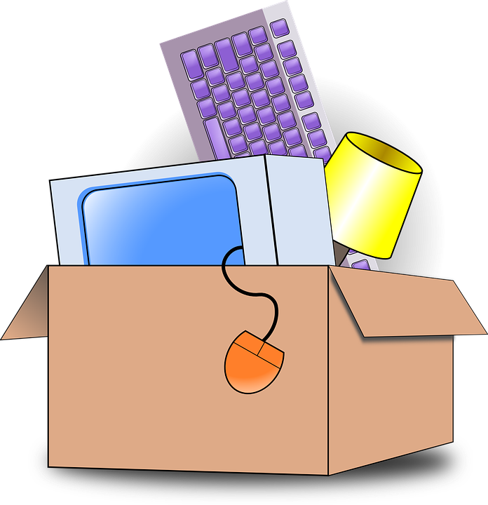
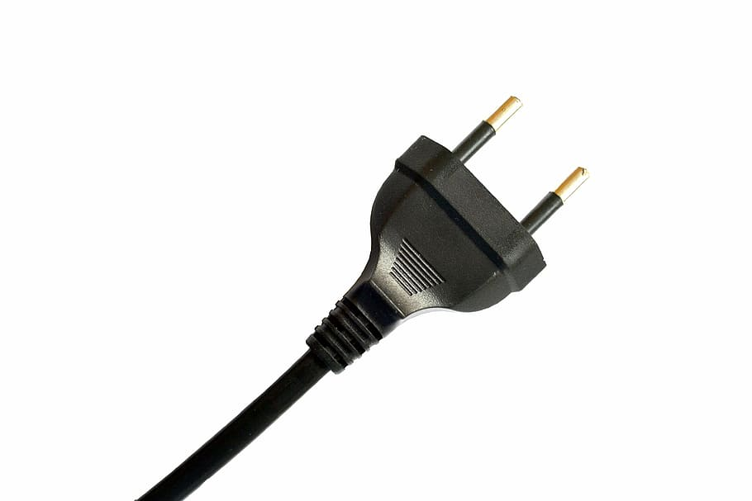
Shared Drive (Q:) Cleanup
Why transfer what you don’t need?
Help reduce impact of security incidents!
Notes:
Benefits of Record Retention
Organization
Can’t compromise what isn’t there.
Great time to clean up your shared drives.
What are the things you did today to help stay protected from harm? What safety precautions do you practice in everyday life. Shout it out! Do you remember specifically when you learned this, but somehow it became common practice for you.
Let my coffee cool down.
We learned this at some point even if it has become something we do without even thinking about it. Because if we don’t, it can lead to danger, risk, injury.
Same is true for practicing cyber safety… those people in our neighborhood. We have a lot of information. Not just about personal data… sensitive research activities…. Threats that

Slide 49
When You’re in the Cloud(s)…
Remember to wear your hats…
Comply (with Safety)
AND Apply (Security)

Slide 50
Contact & Questions
Kevin.R.Brown@uconn.edu
Identity & Access Management
Laurie.Neal@uconn.edu
Information Security
Notes:
Do not spin up your own google accounts.
I pledge not to use my own google accounts as a member of the workforce.

Slide 51
Resources
Security.uconn.edu
Kb.uconn.edu
Policy.uconn.edu
(860) 486 2238

